Slide 1
Intellectual Property
Notes:
NOTE TO THE TEACHER
The notes section of this PowerPoint presentation contains additional information and student exercises.

Slide 2
Video
Source: CBCNews, "Latest TikTok trend breaks movies, TV shows into parts, drawing millions of views"
Notes:
SOURCE
CBCNews, "Latest TikTok trend breaks movies, TV shows into parts, drawing millions of views" (June 13, 2023), online (video) : YouTube <https://www.youtube.com/watch?v=6V6fnwxBg6U>.

Slide 3
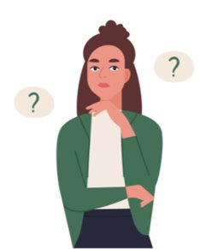
What is intellectual property?
Notes:
SOURCES FOR ANSWERS ARE PROVIDED ON THE NEXT PAGE.
Students must answer the first part of question 1 in the Student Guide.
Ask students to raise their hand and share what they know about intellectual property.

Slide 4
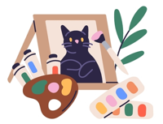
Intellectual property rights protect works created through intellectual activity.
The law usually gives exclusive rights to the work’s creator.
There are many types of intellectual property rights. Here are some examples:
Copyright
Trademark
Patent
Notes:
ADDITIONAL INFORMATION TO SHARE WITH STUDENTS
Words underlined in the slide are links to explanatory videos.
Intellectual property protects works created through intellectual activity, that is, an activity requiring a person to think as opposed to doing something mechanical.
Copyright is a right granted to the creator of an artistic, literary, musical, or dramatic work (or to their representative or a person they assign their rights to). Copyright gives the creator the exclusive right to produce or reproduce all or a significant portion of the work. It also gives the creator additional rights, including the right to receive royalty payments from reproductions of the work.
Some examples of works that can be protected by copyright include a painting, drawing, sculpture, musical composition, building or structure or a model of a building or structure.
Copyright lasts throughout the creator’s lifetime and continues 70 years after their death. So, if you create a work today, it will be protected during your entire life + 70 years.
You’re not required to register your work, but registration provides better protection.
A trademark can be words, sentences, drawings, numbers (or a combination of these things) used by an individual or a company mainly to distinguish their products or services from those of their competitors.
Examples include Apple’s apple, the Nike swoosh, etc. You don’t have to register a trademark, but there are advantages to registration. It grants the trademark owner the exclusive right to use it across Canada for the products or services declared in the registration application.
A patent protects an invention like a product, a process, a machine, or a combination of materials. It gives the patent owner the exclusive right to use and market the invention. The invention must be new, useful, and inventive. An example is a medication or a COVID-19 vaccine.
You must register your invention with the government to get a patent and the exclusive rights described above.
A patent protects the invention for about 20 years.
An industrial design protects the appearance of a finished product or manufactured item, such as its shape, configuration, pattern, or decorative elements. An example of this is the shape of a Coca-Cola bottle. You must register your design with the government for it to be protected. Protection of an industrial design lasts 10 years from the day it is registered.
SOURCES
Copyright
Loi sur le droit d’auteur, LRC 1985, c C-42, arts 2 « œuvre architecturale », « œuvre artistique », « œuvre musicale » et « toute œuvre littéraire, dramatique, musicale ou artistique originale », 3 et 6.
Hubert Reid avec la collaboration de Simon Reid, Dictionnaire de droit québécois et canadien, Montréal, Wilson & Lafleur 2016 sub verso « Auteur (droit d')»
Trademark
Loi sur les marques de commerce, LRC 1985, c T-13, art 2 « marque de commerce » a).
Hubert Reid avec la collaboration de Simon Reid, Dictionnaire de droit québécois et canadien, Montréal, Wilson & Lafleur 2016 sub verso « Marque de commerce »
Patent
Loi sur les brevets, LRC (1985), c P-4, arts 2, « brevet », 43 et 44.
Hubert Reid avec la collaboration de Simon Reid, Dictionnaire de droit québécois et canadien, Montréal, Wilson & Lafleur 2016 sub verso « Brevet »
Industrial design
Loi sur les dessins industriels, LRC (1985), c I-9, arts 2, 3, 9, 10, 11 et 12.

Slide 5
What type of intellectual property rights match the following examples?

Slide 6
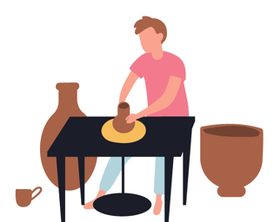
A ceramic artist invents a new way to make ceramics. It revolutionizes the industry!
Example A
1) Copyright 2) Trademark
3) Patent
Notes:
Students answer question 2 in the Student Guide while you’re presenting slides 6 to 10.
Answer: Patent
A patent is the best match for this example.
Remember that the way to make ceramics must meet certain conditions to be patented:
It must be new (first in the world and unknown).
It must be useful.
It must be inventive. (The process must show ingenuity, in other words, it can’t be obvious to a person with basic knowledge working in the field.)
SOURCES
Loi sur les brevets, LRC (1985), c P-4, arts 2, « invention », 27 et 28.
« Procédé de fabrication d'un composite à matrice céramique » Can Brevet n° 2828027, PCT Brevet n° PCT/EP2012/050979 (23 janvier 2012).
« Procédé de préparation d'une céramique frittée, céramique ainsi obtenue et bougie d'allumage la comportant », Can Brevet n° 2634964 (17 juin 2008).
« Revêtement céramique a faible conductivité thermique et de type barrière thermique, procédé de dépôt d'un tel revêtement céramique, et pièce métallique protégée par ce revêtement céramique » Can Brevet n° 2273598 (1er juin 1999).
« Qu'est-ce qu'un brevet? » (28 juin 2021), Office de la propriété intellectuelle du Canada, en ligne: <https://www.ic.gc.ca/eic/site/cipointernet-internetopic.nsf/fra/wr03716.html>.

Slide 7
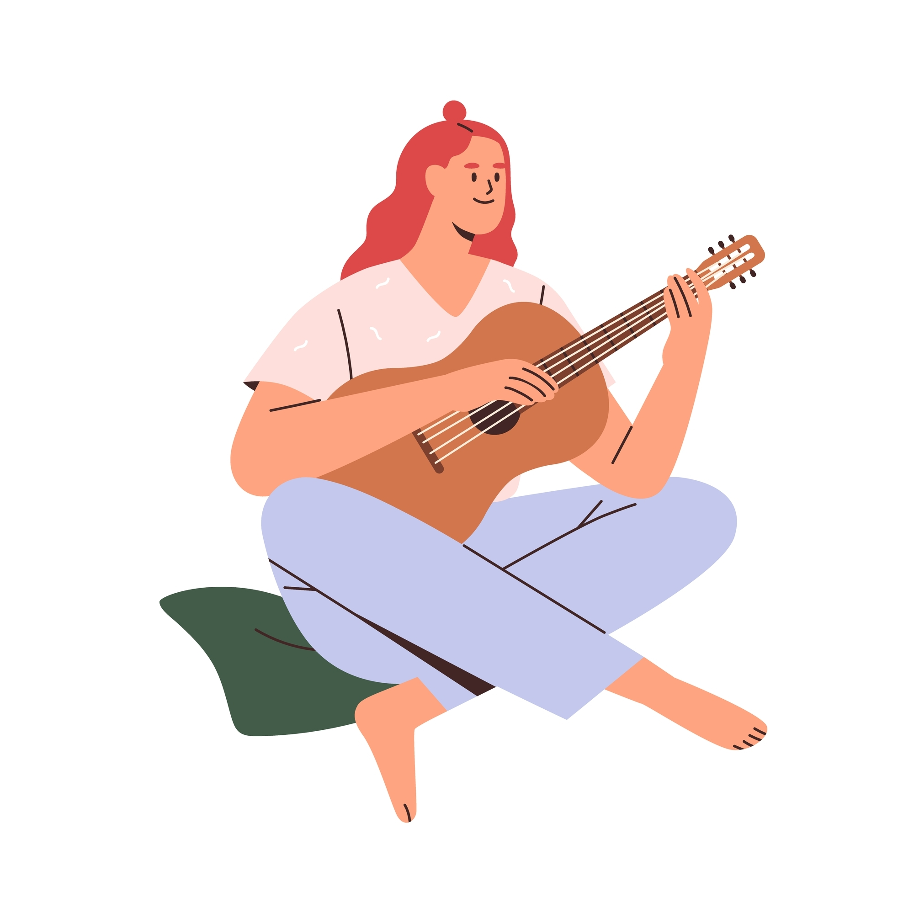
A songwriter writes and records a new song. It gets played on the radio!
Example B
1) Copyright 2) Trademark
3) Patent
Notes:
Answer: Copyright
The law protects the expression of ideas, not the ideas themselves. For example, an idea for a song is just an idea. But if you express this idea in some way, the idea can be protected by copyright. In this case, the songwriter expressed their idea for a song by writing it down and recording it.
Also, a work must be original to be protected. This means the artist must come up with the work on their own and not copy something else. The artist must have put in effort, judgment and a minimum amount of talent.
SOURCES
Loi sur le droit d’auteur, LRC 1985, c C-42, arts 2 « œuvre », « œuvre musicale » 3, 5 et 13.
CCH Canadienne Ltée c. Barreau du Haut-Canada, 2004 CSC 13, paras 8 et 16.
Labelle c Brillant, 2017 QCCQ 12285.
Norac c Toupin, 2009 QCCQ 605.

Slide 8
You create and register a logo for your new business.
Example C
1) Copyright 2) Trademark
3) Patent
Notes:
Answer: Copyright and trademark
The logo you create could be considered a “work” for the purposes of copyright if it meets the legal requirements.
It can also be a trademark if, for example, you place it on your products to distinguish yourself from your competitors.
SOURCES
Loi sur le droit d'auteur, LRC 1985, c C-42, arts 2, « œuvre artistique », 3, 5 et 13.
Techno-Pieux Inc v Techno Piles Inc, 2022 FC 721 (CanLII) aux paras 135 à 138.
Loi sur les marques de commerce, LRC 1985, c T-13, art 2 « marque de commerce » a), 3, 4, 5.

Slide 9
Your friend develops software to monitor sleep cycles.
Example D
1) Copyright 2) Trademark
3) Patent
Notes:
Answer: Copyright
The law considers software to be a literary work, and it can be protected by copyright.
Of course, the software must meet the legal requirements to be protected.
SOURCES
Loi sur le droit d'auteur, LRC 1985, c C-42, arts 2, « œuvre littéraire », « programme d’ordinateur », 3, 5 et 13.
Druide Informatique inc c Éditions Québec Amérique inc, 2020 QCCA 1197
Gestion Reper inc c Brassard, 2013 QCCS 5453, aux para 139-149 (requête en appel refusée: 2014 QCCA 613)

Slide 10
What do you think?
You have a great idea for a book, a logo for your shoe company, or an invention that will change the world.
Does the law protect your idea?
Notes:
Students must answer question 3 in the Student Guide.
Follow-up question:
Does anything change if you share your idea with a friend? After all, shouldn’t your idea be protected now that someone else knows about it?
SOURCES FOR ANSWERS ARE PROVIDED ON THE NEXT PAGE.

Slide 11
The law doesn’t usually protect ideas.
Notes:
ADDITIONAL INFORMATION TO SHARE WITH STUDENTS
Answer: No, intellectual property laws don’t usually protect ideas. Therefore, your idea isn’t protected.
Copyright (book)
Copyright protects a “work” like an artistic, literary or musical work, which means the way that an idea has been expressed in a material form. Examples of a material form include a sheet of paper or a computer document (Word, PDF, etc.).
If you have an idea for a book but you keep it in your head, it isn’t protected by copyright.
Trademark (logo for a shoe company)
An idea for a trademark (for example, a name, logo, or a combination of the two) is not protected. The trademark is only protected once you use it (for example, on products).
Patent (invention)
Your idea for an invention can’t be protected. For example, you have an idea for a vaccine but you haven’t registered it with the government.
You only have a patent for your invention when the government gives you one (Canadian Intellectual Property Office).
Industrial design
Like with a patent, an industrial design must be registered with the government to be protected.
An idea for the shape of a new Coca Cola bottle or a new PlayStation isn’t protected unless you register it.
SOURCES
Copyright
Loi sur le droit d’auteur, LRC 1985, c C-42, arts 2, 5
CCH Canadienne Ltée c. Barreau du Haut-Canada, 2004 CSC 13, paras 8 et 16.
Moreau v St-Vincent, [1950] Ex CR 198 à la p 203.
Trademark
Loi sur les marques de commerce, LRC 1985, c T-13, art 2 « marque de commerce » a).
Mattel Inc. c. 3894207 Canada Inc. 2006 CSC 22, au para 5.
Masterpiece Inc. c. Alavida Lifestyles Inc. 2011 CSC 27, au para 35.
Patent
Loi sur les brevets, LRC (1985), c P-4, art 2, « brevet », « breveté ou titulaire d’un brevet » et « invention ».
Harvard College c Canada (Commissaire aux brevets), 2002 CSC 76, para 40.
Industrial design
Loi sur les dessins industriels, LRC (1985), c I-9, arts 2, 3, 4 et 9.

Slide 12
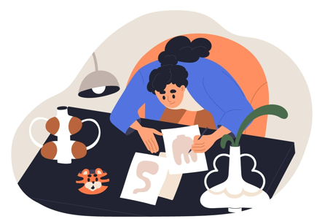
What do you think?
If you draw on a sheet of paper at home, does the law protect your drawing?
Notes:
Students answer question 4 in the Student Guide.
Follow-up question:
If nobody else sees your drawing, does that matter?
SOURCES FOR ANSWERS ARE PROVIDED ON THE NEXT PAGE.

Slide 13
A drawing expressed in a material form can be protected if it meets certain legal requirements.
Notes:
ADDITIONAL INFORMATION TO SHARE WITH STUDENTS
Answer: It depends on certain factors:
As we have seen, the drawing is expressed in a material form, which is a requirement for protection. In this case, the drawing was done on a sheet of paper, but it could also have been done on a tablet/iPad.
However, there must also be a certain amount of talent and thought put into the drawing. Two lines scribbled in the margins of a notebook during class won’t necessarily be protected by copyright. However, a more elaborate drawing might be protected, and this usually grants you exclusive rights as its creator. (In some cases, copyright might belong to someone else.)
Important to note: Copyright usually belongs to the creator. However, there are some exceptions. For example, if the creator makes a drawing as part of their job, copyright usually belongs to their employer.
SOURCES
Loi sur le droit d’auteur, LRC 1985, c C-42, arts 2 « œuvre », « œuvre dramatique » et « programme d’ordinateur », et 13, al 3.
CCH Canadienne Ltée c. Barreau du Haut-Canada, 2004 CSC 13, paras 8 et 16.

Slide 14
You be the judge!

Slide 15
Scenario 1
You recently opened a new shoe store and called it Soulierlala. You’re starting to make a name for yourself in Montreal, and you were even featured in a major newspaper!
(Continued on the next slide.)
Notes:
Students answer the questions for the first scenario in the Student Guide.

Slide 16
Scenario 1
Six months later, your acquaintance, Samuel, opens another shoe store around the corner. It’s also called Soulierlala, and the logo is almost identical to yours.
When you confront him, he says he can do whatever he wants. He says he searched the Canadian Trademarks Database and you never registered your business name or logo.
Is Samuel right?
Notes:
Follow-up question:
If your name and logo aren’t registered, how is Samuel supposed to know they’re protected? Should this matter?
SOURCES FOR ANSWERS ARE PROVIDED ON THE NEXT PAGE.

Slide 17
Using a trademark means you have the right to protect it, not registering it.
What does this mean?
Can you do anything about Samuel?
Notes:
ADDITIONAL INFORMATION TO SHARE WITH STUDENTS
Answer: No, Samuel is wrong and can’t do whatever he wants. You have a right to your name and logo, and he can’t use them.
Use (not registration) creates the right to protect trademarks.
An example of using a trademark is placing it on the products you sell or on the packaging these products are distributed in.
However, remember that registration still has advantages. It gives you the exclusive right to use the trademark across Canada for the products or services declared in your registration application.
Important: An unregistered trademark is only protected where you use it. In this case, your trademark will be protected in the Montreal area but not necessarily in Vancouver.
SOURCES
Loi sur les marques de commerce, LRC 1985, c T-13, arts 2 « marque de commerce » a) , 3, 4, 5 et 50.
Mattel Inc. c. 3894207 Canada Inc. 2006 CSC 22, au para 5.
Masterpiece Inc c Alavida Lifestyles Inc. 2011 CSC 27, au para 35.

Slide 18
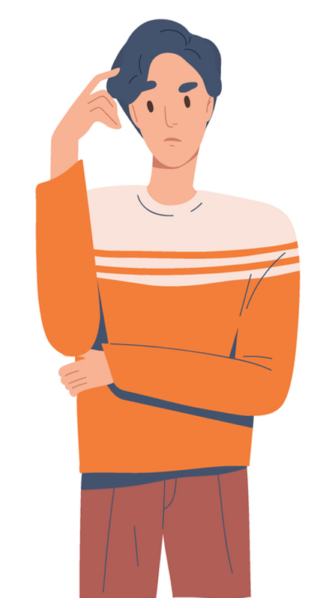
Scenario 1
If Samuel doesn’t change his store’s name and logo, what can you do?
Will Samuel face any consequences?
Notes:
SOURCES FOR ANSWERS ARE PROVIDED ON THE NEXT PAGE.

Slide 19
You can:
Send Samuel a demand letter
Ask a court to make Samuel pay you money for the harm you suffered (damages)
Ask a court to make Samuel stop using your name and logo (injunction)
Notes:
ADDITIONAL INFORMATION TO SHARE WITH STUDENTS
Click on the words “demand letter” (underlined in the slide) to access our article Demand Letters: What Are They?
You must start by sending a demand letter to Samuel. A demand letter formally asks someone to respect a legal obligation within a specified amount of time. In this example, the legal obligation is to not use another company’s trademark without permission.
If Samuel doesn’t do what the demand letter says, you can sue him in court for infringing on your trademark. Suing someone is also sometimes called litigation. You could ask a court for financial compensation for losses resulting from his use of your trademark (damages). You could also ask for a permanent injunction, which is a court order saying that Samuel needs to permanently stop using the name and logo.
In addition, you could request a temporary injunction (interlocutory injunction) so that Samuel stops using your name and logo immediately.
SOURCES
Loi sur les marques de commerce, LRC 1985, c T-13, arts 7, 19, 20, 22 et 51.01.
Pièces d'auto économiques inc. c. 9343-6137 Québec inc., 2017 QCCS 757.
Hyundai Motor America c. Cross Canada Auto Body Supply (West) Limited, 2006 CF 1510, para 1.

Slide 20
What can’t be registered as a trademark?
Notes:
Answers:
First names and family names
A clear description of the product
A false and misleading description of the product
A place of origin
The name of a product in a foreign language
Anything that could be confused with another registered trademark or with a trademark that is in the process of being registered
And more! There are other words and images that aren’t allowed.
SOURCES
Loi sur les marques de commerce, LRC 1985, c T-13, art 12 (1).

Slide 21
Scenario 2
Your company is very successful, and you hire new employees to design and create new products for your store. One of your employees even creates a new logo.
Who owns the rights to the logo?
Notes:
Students answer the questions for the second scenario in the Student Guide.
Follow-up question: Why should the work belong to the employer? After all, the employee created the new logo. Don’t the rights belong to them?
SOURCES FOR ANSWERS ARE PROVIDED ON THE NEXT PAGE.

Slide 22
When an employee creates a work as part of their job, copyright usually belongs to their employer. Employees only keep copyright if their employment contract says so.
Notes:
ADDITIONAL INFORMATION TO SHARE WITH STUDENTS
Answer: The work usually belongs to your company.
The employer owns the copyright for work created by their employees unless the employment contract says something different. And it’s extremely rare for an employee to keep copyright as part of an employment contract.
Note that the rules are different when using the services of freelancers or another company.
SOURCES
Loi sur le droit d’auteur, LRC 1985, c C-42, art 13, al 3.

Slide 23
Scenario 3
You want to use a Montreal musician’s new song in a post on social media (Instagram, TikTok, etc.).
Are you allowed to do this?
Notes:
Students answer the questions for the third scenario in the Student Guide.
Follow-up question: Why shouldn’t you be allowed to do this? Aren’t you giving them free publicity?
SOURCES FOR ANSWERS ARE PROVIDED ON THE NEXT PAGE.

Slide 24
Usually, you can’t use another person’s work without their permission.
Notes:
ADDITIONAL INFORMATION TO SHARE WITH STUDENTS
Answer: You must get permission before using the song.
You usually can’t use another person’s work without their permission.
You can, however, get permission or a licence to use music. One way to do this is by contacting the Society of Composers, Authors and Music Publishers of Canada (SOCAN).
Another social media example: You usually need the photographer’s permission to post a photo, even if it’s a photo of you.
SOURCES
Loi sur le droit d’auteur, LRC 1985, c C-42, artS 5, 27, 29, 29.1, 29.2 et 29.21

Slide 25
Do you remember the legal definition of copyright?
Notes:
NOTES FOR THE TEACHER
The person who owns the copyright for a work is the only person allowed to use it. Nobody else is allowed to reproduce, publish, distribute, or perform a substantial part of the work without permission from the copyright owner.
To learn more and to help prepare for students’ questions: https://educaloi.qc.ca/en/capsules/copyright-protecting-creative-works/
Sources :
Loi sur le droit d'auteur, LRC 1985, c C-42, arts 3, 5 et 6

Slide 26
Copyright
Why does copyright exist?
What do some websites like YouTube do to help artists protect their work?
Notes:
NOTES FOR THE TEACHER
It can be difficult to understand and respect copyright. For the moment and at their age, the most important thing for students to understand is that artistic works (written, visual, musical, etc.) “belong” to a person or a group of people. If we want to use these works, we must ask for permission first and, in some cases, pay the owner to use their work.
To learn more: https://educaloi.qc.ca/en/capsules/copyright-protecting-creative-works/
Sources :
Loi sur le droit d'auteur, LRC 1985, c C-42, arts 3, 5 et 6
Théberge c. Galerie d’Art du Petit Champlain inc., [2002] 2 R.C.S. 336, 2002 CSC 34, para 30-32
Cinar Corporation c. Robinson, 2013 CSC 73

Slide 27
Summary
 | Copyright | Patent | Trademark
What it is | A creator’s exclusive right to use their work | A legal document giving an inventor the exclusive right to use their invention | A mark someone uses to distinguish their goods or services from others
Length of time | Up to 70 years after the creator’s death | Registration = 20 years (not renewable) | Registration = 10 years (renewable)

Slide 28
Scenario based on a real case

Slide 29
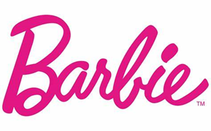
Read the scenario in the Student Guide.
vs.
Notes:
Students answer the questions for the “Scenario based on a real case” in the Student Guide.
Mark, 30, opens his first restaurant in Montreal. It’s a bar and grill that mainly serves barbecued ribs, souvlaki, steak, chicken, and seafood. He calls it “Barbie’s” as a play on words, and one of the items on the menu is the “BarbieQ.” He also designs a logo based on the name. The logo appears at the entrance to the restaurant as well as on menus and some of the restaurant’s products.
After a year in business, the restaurant has become quite successful in the Montreal area. Mark therefore decides to register both the name “Barbie’s” and the logo. He states in his application that the trademark will be used for “restaurant services, take-out services, catering and banquet services.”
The toy company Mattel makes the Barbie doll, which has been a global icon for decades. They’re contesting Mark’s application to register his “Barbie’s” trademark.

Slide 30
The Court’s Decision
The court decided that Mattel’s “Barbie” trademark is only famous for dolls and doll accessories.
Mattel didn’t use the “Barbie” trademark for any other products. So, there’s no risk of confusion with Mark’s restaurant called Barbie’s.
Mark’s trademark application was approved.
Notes:
SOURCES
Mattel Inc c 3894207 Canada Inc, 2006 CSC 22, aux para 82, 91.
Loi sur les marques de commerce, LRC 1985, c T-13, arts 2, « créant de la confusion », « marque de commerce », 6, 7, 20, 22, 45(3), 50, 56(1), (5).

Slide 31
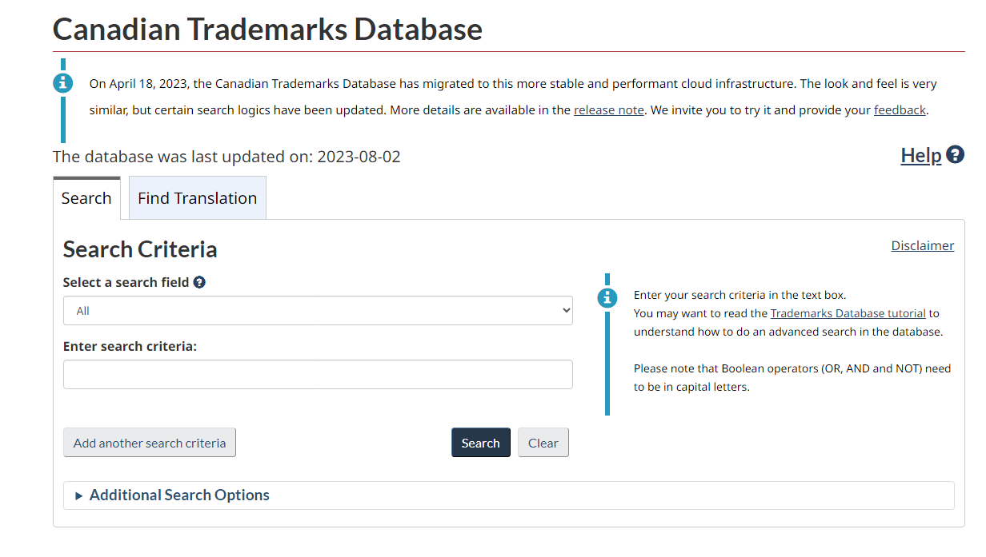
If you’re not sure whether someone has registered a trademark, it’s easy to look it up in the Canadian Trademarks Database.
Notes:
Optional activity: students can do the research exercise in the section “Putting it into practice” of the Student Guide.

Slide 32
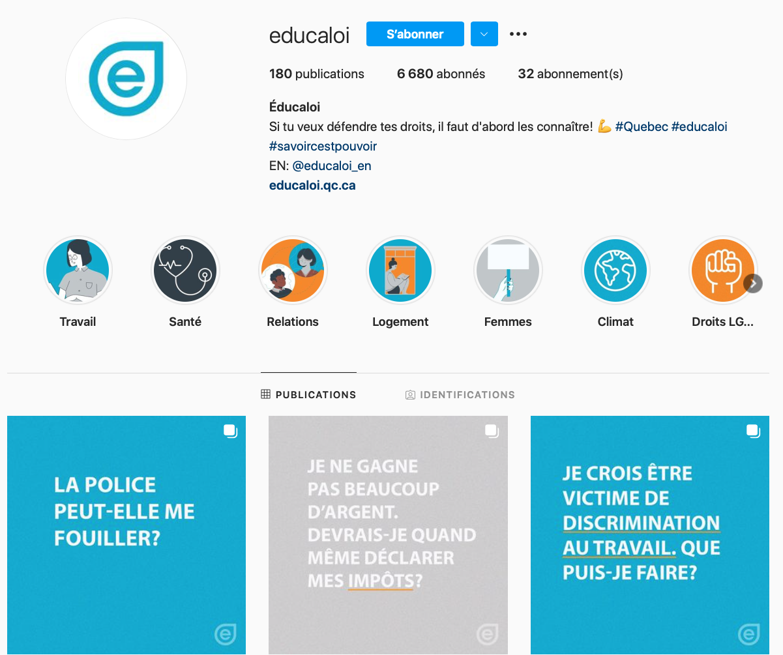
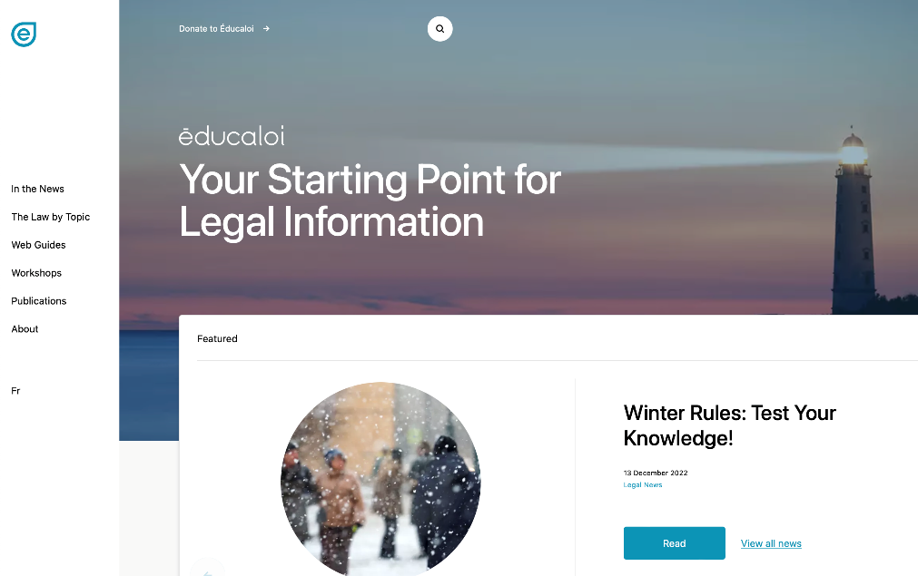
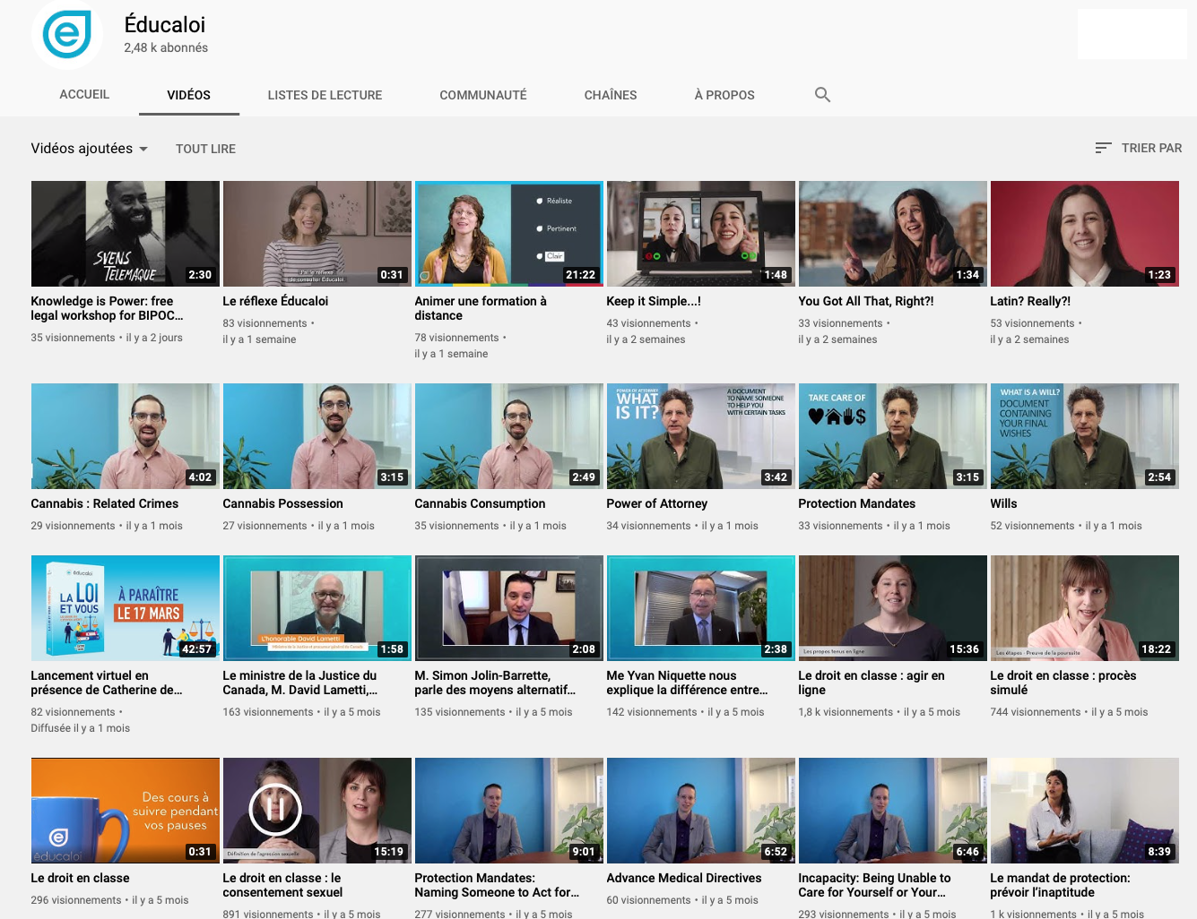
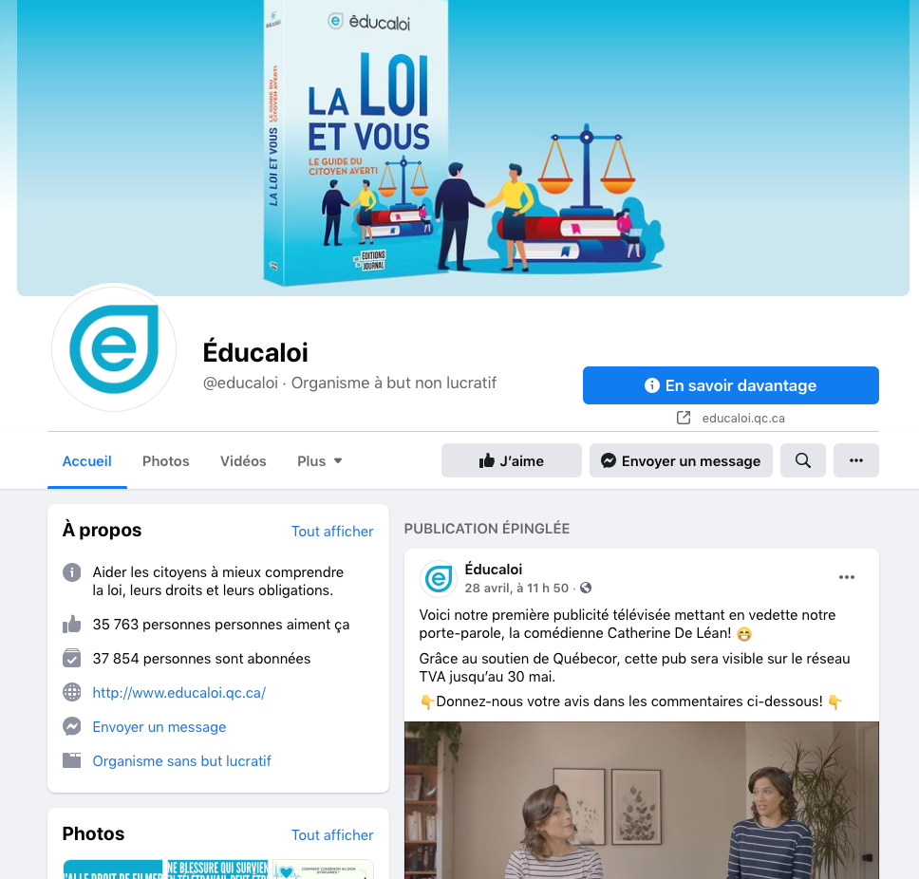
Instagram/educaloi_en
YouTube/educaloi
Facebook/educaloi
educaloi.qc.ca/en

