Slide 1

Are You Old Enough?​
The law:
What are your rights?
What are your responsibilities?
Notes:
TEACHER’S NOTES​
​
This section below each slide contains useful information for teachers.
If you wish, you can print this information to use when presenting the content.​

Slide 2




What is the law?
What is the difference between a rule and a law?​
Give one example of a rule and one example of a law.
Notes:
TEACHER’S NOTES​
​
Ask students these questions and let them answer.​ Write the more thoughtful or frequent answers on the board.
Click to reveal hints.
What is the law?
​
The law can be defined as the set of rules that govern how the members of a society must behave. In other words, the law tells us all what we have to do, what we can’t do, and what we may do. From regular citizens to the prime minister, everyone must obey the rules of law! The law includes:
​
rules for behaviour and relationships in society: crime, traffic, contracts, marriage, divorce, etc.​
a justice system for determining whether an accused person is guilty or not guilty
penalties for people who break the law
​
These rules are written down in a number of documents, including codes, charters, laws and regulations (the Criminal Code, the Civil Code, etc.).​
There are no secret laws: they are all available online for anyone to see. For example, the Criminal Code can be found on the Justice Canada website at laws-lois.justice.gc.ca/eng/acts/c-46/​
​
What is the difference between a rule and a law?
• Rules, whether at home or at school, are not necessarily the same for everyone. For example, a 5-year-old and an 11-year-old in the same family might have different rules for bedtime. At school, students have to do homework, but janitors and monitors don’t. Unlike rules, the law applies to everyone!
• The law is enforced by the police and the courts. For example, a person who steals or attacks another person will be arrested by the police and then tried in court. If a student doesn’t do her homework or a child doesn’t go to bed on time, they will not be arrested by the police! This is because they broke a rule, not a law.
​
RESOURCES​
​
Éducaloi articles on this topic:
​
Quebec and Canadian laws: Laws of Quebec and Canada | Éducaloi (educaloi.qc.ca) (definition of the law, different kinds of law)​
​
​

Slide 3
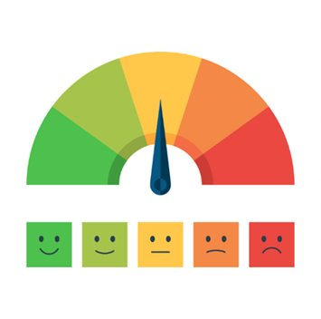
Crime...
What does this mean?
Just because something is not allowed doesn’t mean it’s a crime.​
Notes:
TEACHER’S NOTES​
​
Most of the laws your students will mention are likely crimes (murder, theft, etc.), but not all prohibited behaviour is crime.
​
Generally, crime refers to behaviour that goes against society’s values. There are crimes against the person (murder, physical violence, sexual assault), crimes against property (theft, vandalism, fraud, break and enter), and crimes against society (drug trafficking). When someone commits a crime, they can be charged and convicted. This means that a judge decides what the consequence will be. Most crimes are listed in the Criminal Code, a federal law that applies throughout Canada.
​
Sometimes, people do things that are against the law, but that are not a crime. In some of these situations, they may be ticketed. Some examples include driving too fast, being in a park after it has closed at night, smoking in a non-smoking area, jaywalking, etc.
​
Other things that are against the law can have different consequences. Sometimes, a person who harms someone else has to give them money to compensate for what they did. Some examples of this include defamation, violation of image rights, discrimination, and copyright infringement. For example, if a singer copies part of another musician’s song, the musician can take them to court for part of the money they earned with the copied song.
​
RESOURCES​
​
Éducaloi articles on this topic:
​
Understanding Criminal Law: educaloi.qc.ca/en/capsules/understanding-criminal-law
Understanding Civil Law: educaloi.qc.ca/en/capsules/understanding-civil-law
​
SOURCES​
​
Infractions prévues au Code criminel et dans d’autres lois​
​
Code criminel, LRC 1985, c C-46, art. 21 (modes de participation à une infraction)​
Code criminel, LRC 1985, c C-46, art. 264 (harcèlement criminel)​
Code criminel, LRC 1985, c C-46, art. 222 (homicide) ​
Code criminel, LRC 1985, c C-46, arts 264.1, 265 (voies de fait)​
Code criminel, LRC 1985, c C-46, arts 83.01 et suivants (terrorisme)​
Code criminel, LRC 1985, c C-46, arts 318, 319 (crime de propagande haineuse) :​
Code criminel, LRC 1985, c C-46, art. 322 (vol)​
Code criminel, LRC 1985, c C-46, art. 380 (fraude)​
Code criminel, LRC 1985, c C-46, art. 348 (introduction par effraction) ​
Loi réglementant certaines drogues et autres substances, LC 1996, c 19, art. 5 (trafic de drogues)​
​
Exemples de contraventions​
​
Règlement concernant l’ordre, la sécurité ainsi que les heures d’ouverture et de fermeture des parcs municipaux de la ville de Laval, L‑4510, art. 6.20 (se trouver dans un parc en dehors des heures d’ouverture au public)​
Code de la sécurité routière, RLRQ c C-242, arts 328, 516 (excès de vitesse)​
Loi concernant la lutte contre le tabagisme, RLRQ c L-62, arts 2, 2.1, 2.2 (interdiction de l’usage du tabac dans certains lieux)​
Possibilité de recevoir un constat d’infraction à partir de 14 ans​
​
Code de procédure pénale, RLRQ c C-251, arts 5, 144.​
​
Responsabilité civile​
​
Code civil du Québec, RLRQ c CCQ-1991, art. 1457 (principe général)​
Loi sur le droit d’auteur, LRC 1985, c C-42 (droit d’auteur)​
Aubry c. Éditions Vice-Versa, [1998] 1 RCS 591 (droit à l’image)​
Prud’homme c. Prud’homme, 2002 CSC 85 (diffamation)​
​

Slide 4
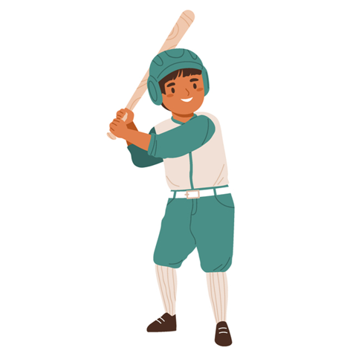
My Responsibilities
Example #1
Who pays to replace the window?
Notes:
TEACHER’S NOTES
Have students work as a team or individually to think about the consequences that the young person may face in each example (Student Notebook). They are not likely to know what the law says about these situations yet, but having them think about it in advance can engage them more deeply and lead to better learning.

Slide 5

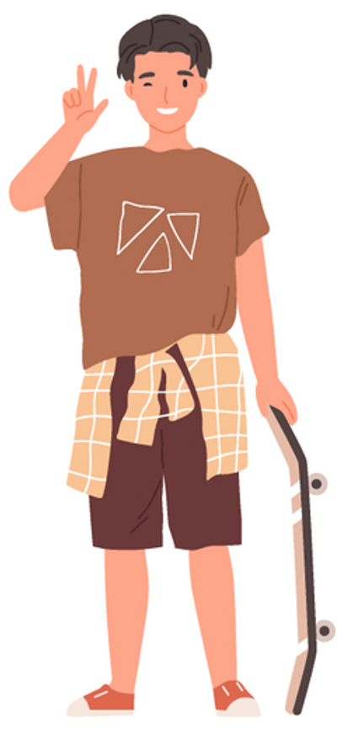


The older we get, the more responsibility society gives us...
Around 7 years old
Civil liability
12 years old
Criminal liability
14 years old
Tickets and fines
18 years old
Age of majority
Notes:
TEACHER’S NOTES​
​
The following slides go into detail about these four types of responsibility.
Then, some examples featuring young people are provided (Student and Teacher’s Guides). Have students try to determine the consequences that these young people may face for their actions.
​
SOURCES​
​
Boyer c Hydro-Québec, (1985) RL 129 (QCCS) ; Baudouin, Jean-Louis. La responsabilité civile, 8e éd., Cowansville, Québec, Éditions Yvon Blais, 2014, par. 1-111, p. 9 (responsabilité civile – 7 ans) ​
Code criminel, LRC, (1985) ch C-46, art 13 ; Loi sur le système de justice pénale pour les adolescents, LC 2002, art 2(1) (responsabilité criminelle – 12 ans) ​
Code de procédure pénale, RLRQ c C-251, art 5 (possibilité de recevoir une amende – 14 ans) ​
Code civil du Québec, RLRQ c CCQ-1991, art 153 al. 1 (majorité – 18 ans) ​

Slide 6
Around 7 years old
Civil liability
My Responsibilities
Starting around 7 years old, children can be held responsible for damage they cause.​
For example, they can be taken to court if they destroy or damage things that don’t belong to them.
Notes:
TEACHER’S NOTES​
​
Vocabulary: Taken to court
​
Children’s civil liability​
• Civil liability means being held responsible if you damage something.​
• Sometimes, people do things that are not a crime, but that engage their civil liability. This means that we have to take responsibility when we are at fault for certain things, and that we have to make things right when we cause harm or damage.
• The law says that we have a duty not to harm others. That’s why if we cause harm, we have to make it right.
Important! Genuine accidents don’t count!
​
• We are only liable (and obliged to fix or compensate the damage we cause to another person) if we are at fault.
So, in cases of children’s civil liability, the first step is to determine if the child was aware of what they were doing and aware of the impact and potential consequences of their behaviour (able to reason and tell the difference between right and wrong).
The law does not say at what age a child has these abilities, but the courts have ruled that at around age 7, a child can be held civilly liable for their actions.
To determine whether a child can reason and tell the difference between right and wrong, the judge observes their intellectual development, understanding, behaviour, etc. If the judge believes that the child is able to reason and tell the difference between right and wrong, he or she will compare what the child did to what a prudent and diligent child of the same age would have done in that situation. If what the child did is different from this standard, they are often considered to be at fault.
• Civil liability only occurs when harm or damage is caused. This can be physical (e.g., bodily injury), moral (e.g., psychological impacts), and material (e.g., breakage, lost wages).
• There must also be a connection between the fault and the harm.
​
RESOURCES​
​
Our article on parents’ legal responsibility for their children’s actions: educaloi.qc.ca/en/capsules/legal-responsibility-of-parents
​
SOURCES​
​
• Code civil du Québec, RLRQ c CCQ-1991, art 1457 (principe général de la responsabilité civile et nécessité d’être doué de raison) ​
Boyer c Hydro-Québec, (1985) RL 129 (QCCS) ; Baudouin, Jean-Louis. La responsabilité civile, 8e éd., Cowansville, Québec, Éditions Yvon Blais, 2014, par. 1-111 (responsabilité civile – 7 ans) ​
• Jean-Louis Baudouin, La responsabilité civile, 8e éd., Cowansville, Éditions Yvon Blais, 2014 au para 1‑102, 104-106, 111, 164, 166, 331, 437​
• Ginn c. Sisson, [1969] C.S. 585 (un enfant âgé de 6 ans et 9 mois a été considéré comme étant doué de raison) ​
​

Slide 7
12 years old
Criminal liability
My Responsibilities
Starting at age 12, you can be charged with a crime.​
​
Teenagers don’t usually go to jail with adults, even if they are convicted of a serious crime.
Notes:
TEACHER’S NOTES​
​
Starting at age 12, people are responsible for the crimes they commit. This means that police can stop a minor age 12 or older for committing a criminal offence (e.g., theft, assault, possession or trafficking of drugs).
​
However, the justice system does not treat teenagers the same as adults! Because of their age, teenagers are often considered to be less mature and more vulnerable than adults (the presumption of “diminished moral blameworthiness”). It is also acknowledged that teenagers tend to challenge authority and may be inclined toward delinquency, but that this behaviour usually goes away as they come of age.
​
So, teenagers are responsible for their actions, but not quite in the same way as adults. The law promotes the rehabilitation and reintegration of young people who commit a crime, including through extrajudicial sanctions (e.g., community service) and protection of their identity.
​
Teenagers have the following rights when they are stopped by police in connection with a crime: the right to remain silent, the right to a lawyer, the right to be accompanied by their parents during police questioning. When teenagers get in trouble with the law, the police will notify their parents as soon as possible.
​
The Teacher’s Notes section of the following slides, which cover tickets and fines, include more information on minors’ rights during police interventions.​
​
​
More information:​
​
Our web guide to the youth criminal justice system:
https://educaloi.qc.ca/en/web-guide/teens-trouble-law/
SOURCES ​:
​
Code criminel, LRC 1985, c. C-46, art. 13 (responsabilité criminelle – 12 ans)​
Loi sur le système de justice pénale pour les adolescents, L.C. 2002, c. 1, art. 2 (1) (definition du mot « adolescent »)​
Code criminel, LRC 1985, c. C-46, art. 495 (arrestation sans mandat)​
Loi sur le système de justice pénale pour les adolescents, L.C. 2002, c. 1, art. 3 (principes applicables aux adolescents en matière pénale)​
Loi sur le système de justice pénale pour les adolescents, L.C. 2002, c. 1, art. 146(2)d) (admissibilité en preuve des déclarations de l’adolescent)​
Loi sur le système de justice pénale pour les adolescents, L.C. 2002, c. 1, 64 (assujettissement d’un adolescent aux peines applicables aux adultes)​
Charte canadienne des droits et libertés, art. 7, 10b) (garanties juridiques: droit au silence, droit à un avocat)​
Code criminel, LRC 1985, c. C-46, art. 129, 495 et 497 (arrestation sans mandat, délivrance d’une citation à comparaitre)​
R. c. Mann, 2004 CSC 52, au para. 19 (definition du terme “détention” en droit criminel)​
Loi sur la justice pénale pour adolescents, L.C. 2002, c. 1, art. 25 par. 1 à 5 (droit à un avocat)​
Loi sur la justice pénale pour adolescents, L.C. 2002, c. 1, art. 6, 10 (avertissements et sanctions extrajudiciaires​
Loi sur le directeur des poursuites criminelles et pénales, LRQ, art 25, al 1 et 2 (nomination et rôle du DPCP)​
Programme de sanctions extrajudiciaires autorisé par le ministre de la Justice et le ministre de la Santé et des Services sociaux, 2016​
Code criminel, LRC (1985), ch. C-46, art. 145 (3) (omission de se conformer à une citation à comparaitre)​
Code criminel, LRC (1985), ch. C-46, art. 503 (comparution)​
​

Slide 8
14 years old
Tickets and fines
My Responsibilities
Once you turn 14, you can be ticketed or fined.​
​
For example, the police can ticket you for littering, being in a park after hours, etc.
Notes:
TEACHER’S NOTES​
​
Generally, the police give out tickets for infractions that are not crimes. Infractions are not criminal offences so, if you get a ticket, you won’t get a criminal record.
Some examples of infractions include: violations of the Highway Safety Code (e.g., jaywalking), violations of municipal by-laws, smoking in non-smoking areas, etc.​
​
The teenager’s parents will also receive a copy of the ticket. When ticketing a young person, the police will ask them to identify themself. This means they must give their name, address, and sometimes their date of birth.
Teenagers who cannot pay their ticket can contact the Bureau des infractions et amendes (the Quebec offences and fines bureau). They may be able to do community service instead of paying the fine.
​
Our rights and obligations if the police stop us​
​
• Regardless of your age, if the police stop you because you broke the law or are suspected of having done so, you must give them your name and address. The police can arrest you and take you to the police station if you refuse to identify yourself or if you provide a false identity when you were required to identify yourself. If the police question you without charging you with an offence, however, you do not have to answer any questions other than giving your identity.
​
The rule about identifying ourselves works both ways: if you ask a police officer to identify themself, they must give you their name and badge number. If you don’t think the police respected your rights or if you think they discriminated against you, you can file a complaint (depliant_public.pdf (gouv.qc.ca)).
​
Note: The police can’t search you or search your bags for no reason. They can only search you in specific situations, for example, if they believe someone’s security is threatened, or if you explicitly give them permission to do so.
​
​
RESOURCES​
​
For more information about receiving a ticket when you are under 18: Teenagers: Tickets and Fines | Éducaloi (educaloi.qc.ca).
​
For more information about your rights when you are stopped by a police officer: Stopped by the Police? You Have Rights! | Éducaloi (educaloi.qc.ca)
For more information about police ethics: Police Ethics | Éducaloi (educaloi.qc.ca)
​
SOURCES​ :
Code de procédure pénale, RLRQ c C-251, art. 144 (constat d’infraction)​
Code de la sécurité routière, RLRQ c C-242, arts 444, 505 (infraction – traverser à un feu rouge)​
Loi concernant la lutte contre le tabagisme, RLRQ c L-62, arts 2, 2.1, 2.2 (interdiction de l’usage du tabac dans certains lieux)​
Code de procédure pénale, RLRQ c C-251, art. 159 (parents reçoivent une copie du constat d’infraction)​
Code de procédure pénale, RLRQ c C-251, art. 72 al. 1 (obligation de donner nom et adresse à un policier en cas d’infraction ou de soupçon d’avoir commis une infraction)​
R c Grant, 2009 CSC 32 aux paras 37‑38 (pas d’obligation de répondre aux questions des policiers en cas d’interception)​
Code de déontologie des policiers du Québec, RLRQ, c P-131, r 1, art. 5 al. 2 (2) (obligation du policier de s’identifier quand une personne lui en fait la demande)​
R c Mann, [2004] 3 RCS 59 au para. 40 ; Pierre Béliveau, Traité général de preuve et de procédure pénales, 22e édition, 2015, Montréal, Les Éditions Thémis ; Montréal, 2015 aux paras 946, 949, 955. (fouille) ​
​

Slide 9
18 years old
Age of majority
My Responsibilities
When you turn 18, you become an adult in the eyes of the law. This means that you have all the responsibilities that adults have.​
Notes:
TEACHER’S NOTES
Most adult responsibilities begin when a person moves out of their parents’ home. This is when they become responsible for meeting their own needs: paying rent, providing for themselves and the people who depend on them (children, parents with loss of autonomy, etc.).
​
Being a parent:
People with parental authority (usually the parents themselves) have a legal duty to supervise, protect, educate, feed, care for, and ensure the safety and health of their children. We will look at children’s rights later on.
​
SOURCES​
​
Code civil du Québec, RLRQ c CCQ-1991, art. 153 al. 2 (majorité – capacité d’exercer pleinement tous ses droits civils) ​
Code civil du Québec, RLRQ c CCQ-1991, art. 598 (autorité parentale)​
Code civil du Québec, RLRQ c CCQ-1991, art. 599 (obligations des parents vis-à-vis de leur enfant)​

Slide 10

My Freedoms
Example #6
Can Mira date Kevin?
Notes:
TEACHER’S NOTES
Have students work as a team or individually to think about whether the young person in the example (Student Notebook) had the legal right to do what they did. They are not likely to know what the law says about these situations yet, but having them think about it in advance can engage them more deeply and lead to better learning.

Slide 11

The older we get, the more freedoms society gives us...
12 years old​
14 years old​
16 years old​
18 years old​
Sexual consent with other teens
Consent to medical care
Driving a
vehicle
Age of majority​
Notes:
TEACHER’S NOTES​
​
Growing up doesn’t just come with responsibilities! The older we get, the more society trusts us.
This trust allows young people to make more decisions for themselves, without their parents necessarily having to agree or even be aware of these choices.
​
SOURCES​
​
Code criminel, LRC 1985, c. C-46, arts 150.1(2) (consentement sexuel avec d’autres ados) ​
Code civil du Québec, RLRQ c CCQ-1991, arts 14 al. 2, 16 al. 2, 17 (consentement aux soins)​
Code de la sécurité routière, RLRQ c C-242, art. 67 al. 2 (conduite automobile) ​
Code civil du Québec, RLRQ c CCQ-1991, art 153 al. 1 (majorité)​

Slide 12




12 years old
Sexual consent with other teens
My Freedoms
If you are
Maximum age difference
12-13 years old
less than 2 years
14-15 years old
less than 5 years
If you are under age 18, your consent is not valid if:​
the older partner is in a position of authority or trust​
you are in a relationship of dependency or exploitation with the older partner.
Notes:
TEACHER’S NOTES​
​
Sexual consent
The rules for sexual consent are set out in the Criminal Code.
Definition of sexual consent:
Consenting to sexual activity means voluntarily agreeing to take part in it.
Consent must be voluntary, meaning it must be a free and informed choice. If the choice is not free and informed, the consent is not valid. Consent is never valid if the person feels forced or threatened into agreeing.
Consent must also be conscious. For example, consent is never valid if the person is unconscious, asleep, or severely intoxicated by alcohol or drugs.
IMPORTANT: The Criminal Code uses the expression “sexual touching”. This can include many things, including kissing. This means that consent is required for a wide range of sexual activities, not just intercourse!
​
Specific rules prohibit sexual touching between people who aren’t the same age:​
Under 12 years old: ​
The law prohibits any sexual touching. Consent is not possible.
​
12-13 years old:​
Sexual touching is permitted if the age difference between the partners is less than 2 years.
This means that a 12-year-old may engage in sexual activity with someone age 12 to age 14-less-a-day. Similarly, a 13-year-old may engage in sexual activity with a person who is under age 15.
​
14-15 years old:​
Sexual touching is permitted if the age difference between the partners is less than 5 years.
For example, a 14-year-old may engage in sexual activity with someone who is 19-less-a-day, but no older.
​
16 years old:
The minimum age to give full and valid consent. Before age 16, the partners must consider whether one of the above rules applies to their situation.
Note: Until 2008, the age of full sexual consent was 14.
​
IN ADDITION, until age 18:
Consent is not valid if the teenager is in a position of vulnerability toward their partner (even if they follow the rules for age difference).
Consent is not valid if the older partner has authority over the younger partner: this generally means having a degree of power over the teenager. Teachers and coaches are generally considered to be in a position of authority.
Consent is not valid if the teenager is in a relationship of trust, dependency or exploitation with the older partner.
Dependency generally means that the teenager depends on the other person, for example for care or support, or that the other person has a certain amount of power over the teenager, who is in an inferior position.​
Trust generally means that the older partner uses their position to make the teenager feel protected. There is therefore a relationship of influence or persuasion, so the teenager is in a position of vulnerability or weakness.
Exploitation generally means that the older partner takes advantage of the teenager’s vulnerability. It involves a notion of control over the teen.
Relationships of trust, dependency, or exploitation are assessed on a case-by-case basis.
​
Parents’ role
Parents have a legal duty to care for and supervise their children. As such, they have a say in who their children date. They may prohibit their child from seeing a lover if they believe this to be in the child’s best interest.​
​
SOURCES​
Code criminel, LRC 1985, c C-46, art 150.1 (2) et (2.1), 151, 153, 273.1​
R. c. Audet, [1996] 2 RCS 171​
R. c. L. (D.B.) (1995), 43 CR (4th) 25 (CA ONT)​
R. c. Léon, [1992] RL 478 (QC CA), 1992 CanLII 3818.​

Slide 13
14 years old
Consent to medical care
My Responsibilities
Starting at age 14, people can refuse or consent to their own medical care. ​
​
What are some examples of medical care?
Notes:
TEACHER’S NOTES​
​
Generally, the minimum age to refuse or consent to medical care is 14 years old.​
Before this age, children may not make their own medical decisions, and their parents decide whether to accept or refuse care for the child.
Parents must make this decision in the child’s best interests only: not on the basis of their own beliefs. If possible, they should also consider the child’s wishes.
​
Starting at age 14, teenagers can generally consent to medical care on their own. This includes things like abortion, hospitalization, medication, blood tests, reconstructive surgery for burns, etc.
“Medical care” refers to anything related to a person’s health. Here are some examples:​
medical exams
blood samples
medical treatment and intervention​
Medical care can be for the body or the mind. Seeing a psychologist, for example, is considered medical care.​
​
Notes:​
If a minor has to stay in a health care facility for more than 12 hours, their parents must be notified.​
If a minor over age 14 refuses to receive medical care that is required by the state of their health, only the court can authorize medical practitioners to treat the child against his or her will.
A teenager’s parents can give consent to medical care in an emergency if the child’s life is in danger.
​
Care that is not required by a person’s state of health:
​
Teenagers age 14 and over may also refuse or consent to medical care that is not required by the state of their health. However, if this care poses a serious risk to the teenager’s health AND could cause serious and permanent effects, the parents’ consent is also required. For example: Maxime wants cosmetic surgery to change the shape of his nose. Maxime needs his parents’ consent, because this is not required by his state of health, it poses a serious risk to his health, and it could cause serious and permanent effects.
Contrary to popular belief, the law does not specifically state that people must be 18 or older to get a tattoo or piercing, but tattoo businesses are allowed to refuse services to minors. (educaloi.qc.ca/en/capsules/piercing-and-tattoos)
Since 2013, minors can no longer use tanning beds because of the health risks involved.
​
SOURCES​
Code civil du Québec, RLRQ c CCQ-1991, art. 12 al. 1, 14, 16-18 (consentement aux soins) ​
Code civil du Québec, RLRQ c CCQ-1991, art. 33 (intérêt de l’enfant)​
Robert P. Kouri et Suzanne Philips-Nootens, L’intégrité de la personne et le consentement aux soins, 3e éd, Cowansville, Éditions Yvon Blais, 2012, aux pages 424 et ss (soins requis par l’état de santé), 493 et ss. (soins non requis par l’état de santé). ​
​

Slide 14
16 years old
Driving a vehicle
My Freedoms
Starting at age 16, you can get a driver’s license. Like all other drivers, teenagers must follow the rules of the Highway Safety Code!​
​
Do you know any rules from this Code?​
​
What happens if a driver breaks these rules too many times?
Notes:
TEACHER’S NOTES​
​
Students will likely name familiar traffic safety rules like speed limits, traffic lights and stop signs. Take this opportunity to explain that the Highway Safety Code does not only cover people driving vehicles. It also covers:
​
cyclists and pedestrians​
obligations related to maintenance, tire changes, registration, etc.​
the conditions for getting a licence
When a new driver first gets their driver’s licence, they are given a two-year probationary licence. This means that they must follow special rules, including:
zero tolerance for alcohol​
only four demerit points before they lose their licence​
SOURCES​ :
Code de la sécurité routière, RLRQ c C-242, art. 67 al. 2 (conduite automobile – 16 ans) ​
Code de la sécurité routière, RLRQ c C-242, art. 1 al. 1 (le Code de la sécurité routière s’applique aussi aux cyclistes et aux piétons) ​
Code de la sécurité routière, RLRQ c C-242, arts 6-60 (immatriculation) ​
Code de la sécurité routière, RLRQ c C-242, arts 270 (pneus doivent respecter normes établies par règlement)​
Code de la sécurité routière, RLRQ c C-242, arts 65-83.1 (conditions pour obtenir son permis) ​
​
​

Slide 15
18 years old
Age of majority
My Responsibilities
When you turn 18, you become an adult in the eyes of the law.
This means that you have all the freedoms that adults have. ​
​
​
What freedoms do 18-year-olds have that 17-year-olds don’t?
Notes:
TEACHER’S NOTES​
​
Here are some possible answers:​
buying alcohol, cigarettes and lottery tickets​
making their own financial decisions​
voting, running for election​
SOURCES​
​
Code civil du Québec, RLRQ c CCQ-1991, art 153 (majorité)​
Loi sur les infractions en matière de boissons alcooliques, RLRQ c I-81, art. 103.9 al. 1(2) a contrario (possibilité d’acheter de l’alcool) ​
Loi concernant la lutte contre le tabagisme, RLRQ c L-62, art. 13.2 al. 1 a contrario (possibilité d’acheter des cigarettes)​
Loi sur la Société des loteries du Québec, RLRQ c S-131, art. 25.1 a contrario (possibilité d’acheter des billets de loterie) ​
Loi électorale, RLRQ c E-33, art. 1 al. 1(1) (droit de vote au Québec) ; Loi électorale du Canada, LC 2000 c 9, art. 3 (droit de vote au fédéral)​
​

Slide 16

My Protections
Example #11
What will the judge decide in Julie’s parents’ custody case?
Notes:
TEACHER’S NOTES
We have looked at parental responsibility, but this responsibility goes hand in hand with children’s rights.
Children know that society treats them differently from adults. They tend to be aware of all the things adults may do that children may not. But they are not always aware that society also gives them protections that adults don’t have!
Have students work as a team or individually to think about whether the law would protect the teenager in the example (Student Notebook). They are not likely to know what the law says about these situations yet, but having them think about it in advance can engage them more deeply and lead to better learning.

Slide 17
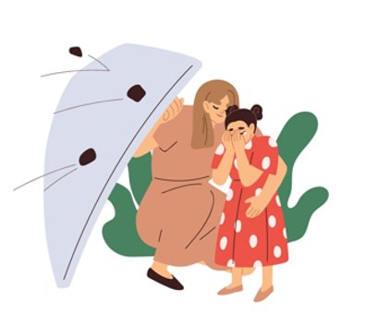
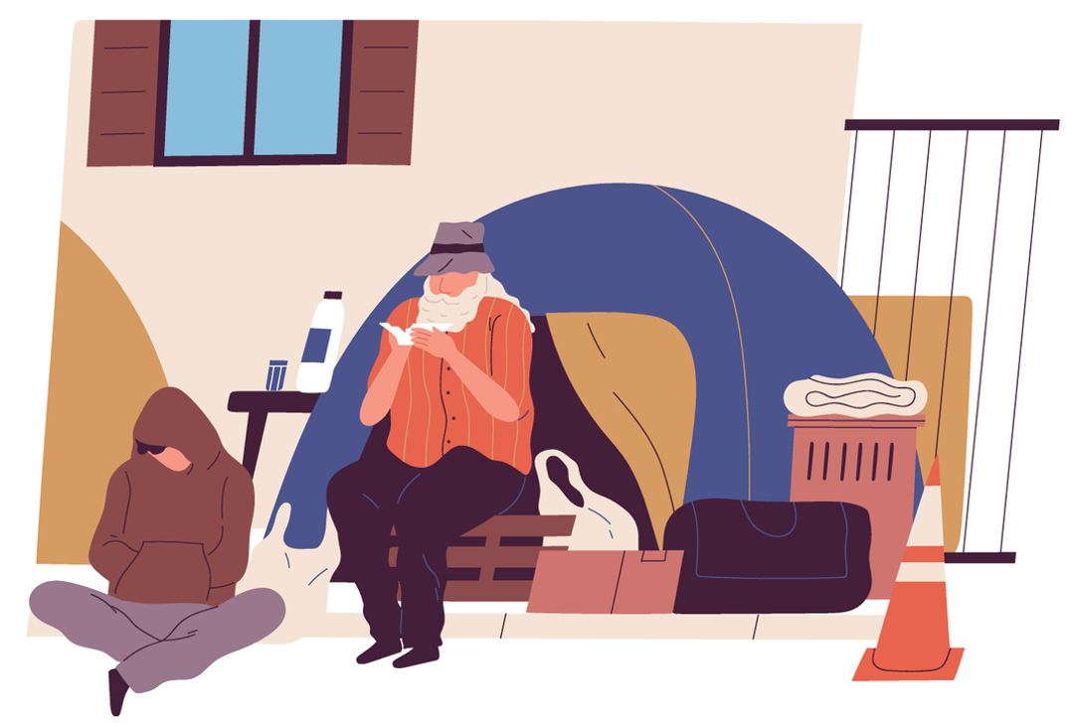
Youth protection (DYP)
The Youth Protection Act protects minors (people under age 18).​
​
It allows the DYP to intervene if a minor is not safe, or if their development is in danger.
​
What are some situations where the DYP could be contacted?
Notes:
TEACHER’S NOTES​
​
The DYP must be contacted if a child’s basic needs are not being met or if a child is not safe.
Here are some examples:​
Children who are being neglected:​
their basic needs of food, clothing, hygiene, and housing are not being met
they are not receiving the medical care they require for their physical or mental health
they are not receiving appropriate education
Children who are experiencing physical or sexual abuse ​
Children who are experiencing psychological abuse ​
Every adult who works with children or teenagers has a legal duty to inform the DYP of any situation that they have sufficient reason to believe is harmful to a child’s development. This includes all the examples listed above. Other adults are not required to report these situations to the DYP, but may do so if they wish.
​
​
MORE INFORMATION​
​
For more information about situations in which the DYP can intervene: The Role of the Director of Youth Protection (DYP) | Éducaloi (educaloi.qc.ca)
How to report a situation to the DYP: How to report a situation to the DYP | Éducaloi (educaloi.qc.ca)
The Youth Protection Act, like all Canadian and Quebec laws, is available online: P-34.1 - Youth Protection Act (gouv.qc.ca)
SOURCES​
​
Loi sur la protection de la jeunesse, RLRQ c P-341, arts 2, 38, 39. ​

Slide 18
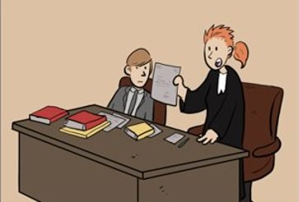
Lawyers
The law is a complicated subject, even for adults!​
That’s why it is usually free for a child or teenager to be represented by a lawyer.​
​
For example:​​​
teenagers accused of a crime​
children or teenagers whose best interests are contrary to those of their parents​
Notes:
TEACHER’S NOTES​
​
Because legal aid is based on a person’s income, children and teenagers who don’t have a job (and therefore no income) generally qualify for a free legal aid lawyer.​
​
What do we mean by children whose best interests are contrary to those of their parents?
Here are some examples:​
children who want to have their say in a custody dispute
people under age 14 who want to be vaccinated, but their parents refuse: minors may ask the court for authorization to be vaccinated without their parents’ consent
young people who bear the last name of a parent with whom they don’t have a relationship with may ask the courts for permission to change their last name
These situations are fairly exceptional and judges must always make their decision in the best interests of the child.​
​
​
More information:​
​
Our articles on legal aid for children and teens:​
educaloi.qc.ca/en/capsules/legal-aid-for-children-and-teens ​
​
The Commission des services juridiques:​
https://www.csj.qc.ca/commission-des-services-juridiques/aide-juridique/les-mineurs-sont-ils-admissibles/en​
​
​
SOURCES​
​
Charte des droits et libertés de la personne, RLRQ c C-12, art. 34 (toute personne a droit à un avocat)​
Droit de la famille – 2224 [1995] R.D.F. 396, au para. 399 (les enfants peuvent confier un mandat à un avocat)​
M.F c. J.L, 2002 CanLII 36783 (QCCA), au para. 29 (cas où un enfant peut être représenté par avocat)​
Code de procédure civile, RLRQ c C-25.01, art. 90 (le tribunal peut ordonner la représentation du mineur par un avocat pour protéger ses intérêts)​
Code civil du Québec, RLRQ c CCQ-1991, art. 159 (possibilité pour le mineur d’intenter seul une action relative à l’exercice de l’autorité parentale)​
Droit de la famille - 061113, 2006 QCCS 7658 au para. 43 (l’autorisation prévue à l’art. 159 C.c.Q. doit uniquement être accordée pour des motifs sérieux)​
K.D. c. M.B. (C.S., 2003-02-12), SOQUIJ AZ-50163654, J.E. 2003-548, [2003] R.D.F. 291 au para. 46 (dans le cadre d’un recours sur le fondement de 159 C.c.Q., c’est à l’enfant de démontrer que ses intérêts sont opposés à ceux de ses parents)​
Droit de la famille — 09746, 2009 QCCA 623 ; Droit de la famille - 091926, 2009 QCCS 3441 (exemples de cas où l’enfant a été autorisé à agir seul)​
Code civil du Québec, RLRQ c CCQ-1991, art. 33 (intérêt de l’enfant)​
Règlement sur l’aide juridique, c. A-14, r. 2, art. 6.1, 7, 39 ​
J. Sébastien VAILLANCOURT, Le rôle et l’utilité du procureur à l’enfant devant la Cour supérieure, Congrès du Barreau, juin 2010 ​

Slide 19


The Education Act
In Quebec, all children between the ages of 6 and 16 must attend school. Public school must be free (other than school supplies).​
​
School staff must:​
educate students according to the curriculum​
treat all students fairly​
protect students from violence​
Notes:
TEACHER’S NOTES​
​
Here are more details about teachers’ obligations under the Education Act.
Teachers have a legal duty to:
contribute to the intellectual and overall personal development of each student entrusted to their care
take part in instilling a desire to learn into each student entrusted to their care
take the appropriate means to foster respect for human rights in their students
act in a just and impartial manner in their dealings with students
take the necessary measures to promote the quality of written and spoken language
take the appropriate measures to attain and maintain a high level of professionalism
collaborate in the training of future teachers and in the mentoring of newly qualified teachers
comply with the educational project of the school
​
​
The law requires every school to adopt an anti-bullying and anti-violence plan.
This plan must include:​
prevention measures to put an end to all forms of bullying and violence​
procedures for reporting bullying or violence
measures to protect the confidentiality of any report, complaint, other information related to bullying or violence
support measures for victims and witnesses​
A document explaining the anti-bullying and anti-violence plan must be distributed to all parents.
​
RESOURCES​
​
Our article on bullying and violence at school: https://educaloi.qc.ca/en/capsules/bullying-and-violence-in-quebec-schools/
​
SOURCES​
​
Loi sur l’instruction publique, RLRQ c I-133, art. 14 (obligation de fréquentation scolaire)​
Loi sur l’instruction publique, RLRQ c I-133, art. 22 (obligations de l’enseignant)​
Loi sur l’instruction publique, RLRQ c I-133, art. 75.1 (plan de lutte contre l’intimidation et la violence)​
​

Slide 20

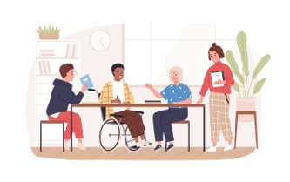
The Quebec Charter of Human Rights and Freedoms​
The Charter protects everyone in Quebec, which means both children and adults!
It guarantees:​
your right to life and personal security
your right to freedom of expression​
your right to protection against discrimination
Notes:
TEACHER’S NOTES​
​
​
The Commission des droits de la personne et de la jeunesse website explains young peoples’ rights according to the Quebec Charter of Human Rights and Freedoms, the Direction de la protection de la jeunesse, and the international Convention on the Rights of the Child: https://cdpdj.qc.ca/en/your-rights/rights/young-people ​
​
SOURCES​
​
Charte des droits et libertés de la personne, RLRQ c C-12, arts 1, 3, 10, 40​

Slide 21
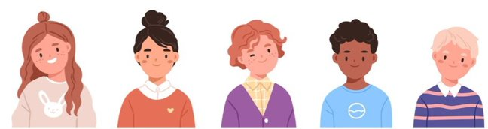

The Convention on the Rights of the Child
This convention has been signed by almost every country in the world, including Canada.​
​
It is not a law. It is a statement of principles, meaning a promise that all these countries have made. They have all promised to act in the “best interests of the child”.​
What do you think this means?
Notes:
TEACHER’S NOTES​
​
The UN Convention on the Rights of the Child was adopted on November 20, 1989. World Children’s Day is celebrated annually on November 20 to commemorate the Convention.
Of the 193 UN members, the United States is the only country that has not ratified the Convention. This is because the Convention prohibits life sentences for minors, a penalty that is still permitted in some parts of the United States.
​
What does the best interests of the child mean in court decisions?
making custody decisions based on the best situation for the child, not the adults in the child’s life
taking children’s views into account in all decisions that concern them
​
The full Convention is available here: https://www.ohchr.org/sites/default/files/crc.pdf ​
​
SOURCES​
Convention relative aux droits de l’enfant, 20 novembre 1989, arts 3 et 12. ​

