Slide 1
A Career in Law?
Insert English logo here.
Notes:
NOTE TO EDUCATORS
Each slide includes important comments:
NOTE TO EDUCATORS: Instructions for carrying out the activity
INFORMATION FOR STUDENTS: Information to give students
The “gears” icon on slides 3, 11, 13 and 27 indicates suggestions for encouraging student participation.
You can adapt the presentation to your students’ needs.
© Éducaloi, 2017

Slide 2
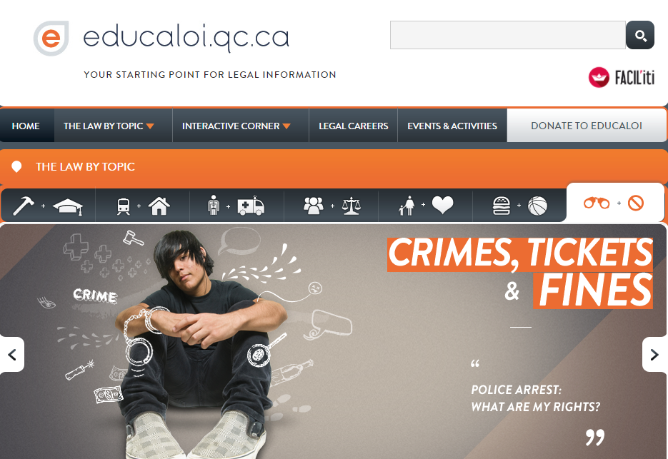
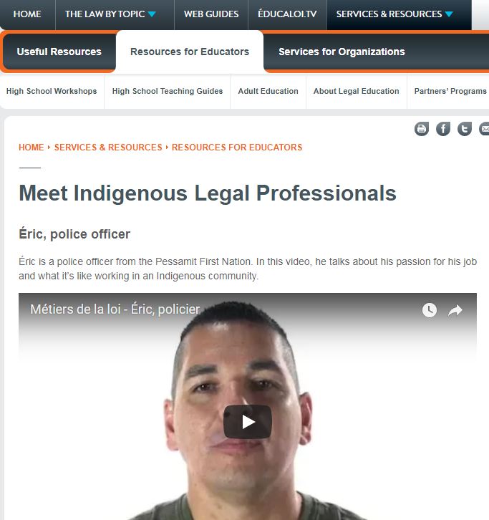
Notes:
ABOUT ÉDUCALOI
To begin, present Éducaloi’s website to students. It has free legal information they can use in their daily lives:
work and school
vehicles and housing
health
families and relationships
shopping and leisure
crimes, tickets and fines
the justice system
There’s also an entire section on legal careers: www.educaloi.qc.ca/en/youth/legal-careers

Slide 3
Know any careers that involve the law?
Notes:
NOTE TO EDUCATORS
Class before the activity
Help students discover different careers by having them read the career fact sheets on Éducaloi’s website educaloi.qc.ca/careers. It’ll be easier for them to answer questions and score points. You can also print the fact sheets for your students.
The activity
Divide the class into groups of three or four students.
Distribute the materials: 12 puzzle pieces to cut out and one puzzle board per team.
Ask students if they know of any careers that involve the law. Here are possible answers:
Legal secretary, probation officer, correctional officer, aboriginal offender support officer, lawyer, band chief or councillor, courtworker, Member of Parliament/Member of the National Assembly, bailiff, court usher, legal interpreter, judge, addiction worker, police officer, notary, official stenographer, paralegal, legal translator, social worker, etc.
INFORMATION FOR STUDENTS
You have access to a wide variety of careers, as long as you work hard. You have many options apart from being a lawyer or a judge.
The activity is a game. The team with the most points from the puzzle and quiz wins!

Slide 4
Puzzle Time!
Each puzzle piece gives information about a career.
You have 10 minutes to solve the puzzle.
Earn one point for each correct answer.
Notes:
INFORMATION FOR STUDENTS
Instructions:
Divide into teams of three or four. Using your personal knowledge, complete the puzzle by placing the pieces on the puzzle board.
Each piece has information about a career (for example, a picture, a list of duties or necessary training.
You have 10 minutes to solve the puzzle.
The solution is revealed as the careers are presented (slides 7, 10, 15 and 19). Pay close attention so as not to miss important information!
Scoring:
One point for each puzzle piece in the right place.

Slide 5
Judge
Listen – Decide – Manage

Slide 6
Mark Philippe
Innu Community of Mashteuiatsh
Persevere! It’s not always easy, but you’ll see how strong you are when things get tough.
I’m the first Indigenous judge on the Court of Quebec. Yes, we can take our place in society.
Our communities must be represented in the justice system.
Notes:
INFORMATION FOR STUDENTS
Mark Philippe is from the Innu community of Mashteuiatsh on the shores of Lac St-Jean.
He became interested in law at the end of CEGEP when he realized how much the law is involved in all aspects of our lives.
He earned a Bachelor’s degree in law at Université de Montréal and became interested in criminal law.
I quickly realized that criminal law was what I wanted to do. I was fascinated by the courtroom and the human stories that unfolded there.
Mark Philippe became a lawyer and handled some important cases of robbery, sexual assault and murder.
In 2017, he was appointed to the Court of Québec in Gatineau. He is one of the youngest Indigenous judges in the history of Quebec.
As a judge, I’m at the centre of the action. I’m in court almost every day and have to decide legal issues. I’m very passionate about my work!

Slide 7
Judge
Puzzle Answers
Duties | Training
Manage court cases Decide cases Listen to testimony Analyze evidence | Lawyer or notary for at least 10 years Chosen by the government
Notes:
INFORMATION FOR STUDENTS
Judges preside over civil and criminal cases. They make decisions to settle legal disputes.
Salary
The law sets the salary of judges, and it varies depending on where they work. Most get paid over $200,000 a year.
Job prospects
Job prospects are limited.
Did you know?
Legal disputes in several regions of Quebec are settled by an Itinerant Court. This means that judges travel to these regions for several days to hear various cases.
In some communities, hearings are held in schools or community centres because there are no courthouses.

Slide 8
Lawyer
Represent – Advise – Negotiate
Notes:
INFORMATION FOR STUDENTS
Special admissions policy at Université de Sherbrooke
The law faculty at Université de Sherbrooke has a special admissions policy in favour of Indigenous applicants.
First Nations, Inuit or Métis students can identify themselves as Indigenous on the admission form.
Grades are still an important factor for admission but other criteria are also considered.

Slide 9
Martha Montour, Lawyer & Accredited Mediator

Slide 10
Lawyer
Puzzle Answers
Duties | Training
Advise clients Negotiate and represent clients in court Analyze documents and situations Write legal documents | Bachelor’s degree in law Training at the École du Barreau (bar school) Six-month practical training
Notes:
INFORMATION FOR STUDENTS
Lawyers represent and give advice to clients. Lawyers answer their clients’ legal questions and help them understand their rights.
Salary
Lawyers’ salaries depend on their experience, the types of clients they have and their specialty. Salaries range from $30,000 to $300,000 a year.
Job prospects
Job prospects for lawyers are generally good, but a 2016 report published by the Young Bar Association of Montreal revealed that there are fewer job opportunities for lawyers in recent years.
Did you know?
Not all lawyers work in court. Many spend most of their time in their offices, writing documents or negotiating settlements.
Lawyers can work in different fields, such as criminal law, labour law, ancestral rights and territorial claims.

Slide 11
If you were a criminal lawyer, could you defend people accused of very serious crimes?
Notes:
NOTE TO EDUCATORS
Suggested topics for discussion:
A key principle in the Canadian legal system is the presumption of innocence. This means the accused is considered innocent until proven guilty.
It’s not up to the accused to prove their innocence. Rather, the burden is on the prosecutor (criminal and penal prosecuting attorney) to prove beyond a reasonable doubt that the accused is guilty.
Even if guilty, the accused has the right to a fair hearing.
Defence lawyers must protect their clients against possible abuses from the justice system, such as rights violations, errors made by police officers and unfair sentences.
Some people believe that defence lawyers conspire with their clients and help them come up with lies to get out of trouble. But this is not true.
A lawyer can still defend a client who admits to the crime but can’t lie in court. A lawyer who lies in court could lose the right to practise law and be accused of a crime (collusion to commit perjury).
Lawyers must defend the accused to the best of their abilities, but they must do so legally.
Defence lawyers are not forced to defend someone if it’s against their principles. They can refuse to defend a client accused of a very serious crime.
Sources:
Canadian Charter of Rights and Freedoms, s 7.
Criminal Code, ss 131 and 718.2 (b).
Professional Code, s 156.
R v Legato, 2002 CanLII 41296 at para 88 (QCCA) .
Code of Professional Conduct of Lawyers, ss 14 and 116.

Slide 12
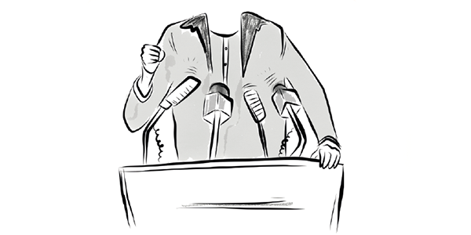
Band Councillor or Chief
Decide – Communicate – Represent

Slide 13
Puzzle Answers
Can you name a band chief or band councillor?
Notes:
INFORMATION FOR STUDENTS
Ask students if they know of any band band chiefs or councillors.
Teams that can answer the question score a point.
The team that names the most band councillors or band chiefs scores a bonus point.
NOTE TO EDUCATORS
To check students’ answers, we recommend shutting the PowerPoint presentation and using an online search engine or the official websites of the communities mentioned.
To encourage discussion, ask students questions about their communities or talk about current events.

Slide 14
Band Chief or Councillor
Puzzle Answers
Duties | Training
Develop projects Make bylaws Represent the community Manage programs | No specific training
Notes:
INFORMATION FOR STUDENTS
The band council is made up of
councillors who make decisions on issues that affect the community, and
a band chief who is the head of the band council and represents the community in its relationships with governments and other First Nations.
Salary
Their salary depends on the territory covered and which nation they represent.
A band councillor can earn $4,200 to $104,000 a year.
A band chief can earn $33,000 to $138,000 a year.
Job prospects:
Job prospects are limited.
Each band has one chief and about five councillors. In Quebec, there are 33 chiefs and 147 councillors in all. They are elected or chosen based on custom, and they only hold the position for a few years.
Did you know?
This is a very rewarding career, but it’s not always easy. There can be a lot of pressure from community members, and you must be available after regular office hours.

Slide 15
Did you know?
Like Members of Parliament and Members of the National Assembly, band chiefs and band councillors
represent people
debate political issues
Notes:
INFORMATION FOR STUDENTS
There are similarities between MPs/MNAs and band chiefs or councillors.
MPs vote on laws at the federal level, and MNAs vote on laws at the provincial level.
Some MPs/MNAs are appointed as ministers responsible for special matters, such as Indigenous affairs, health or education.
For example, Jody Wilson-Raybould is the MP for the federal riding of Vancouver Granville, and she is also Canada’s Minister of Justice.

Slide 16
Police Officer
Protect – Prevent – Maintain Order

Slide 17
Éric Hervieux
Pessamit First Nation
‘’Our communities need Indigenous police officers. It’s easier to relate to people when you speak their language and know what they’ve been through.’’
Notes:
INFORMATION FOR STUDENTS
Éric Hervieux is from the Pessamit first nation située dans la région de la côte Nord, le long du fleuve Saint-Laurent.
*Informations à insérer
https://educaloi.sharepoint.com/:x:/r/projets/_layouts/15/WopiFrame.aspx?sourcedoc=%7B5E7BDE3C-2B62-400E-A467-300C765C1CCF%7D&file=Mod%C3%A8les.xlsx&action=default&IsList=1&ListId=%7BEBF0D174-E1F9-4A08-88CB-BE86724C251E%7D&ListItemId=227

Slide 18
Police Officer
Puzzle Answers
Duties | Training
Respond to emergencies Gather evidence Be visible in the community Raise public awareness | DEC or Attestation of College Studies* in police technology Training at the École Nationale de Police du Québec (ENPQ)
*In some cases. See the Police Officer fact sheet on Éducaloi’s website.
Notes:
INFORMATION FOR STUDENTS
Police officers have an important role in society. They prevent crimes and protect the public.
Salary
The salary of police officers depends on their seniority and responsibilities.
For example, a police officer with the Sûreté du Québec earns $40,000 to $76,000 a year.
Job Prospects
Job prospects are generally good.
But they are limited in Abitibi-Témiscamingue, Côte-Nord and Nord-du-Québec.
Did You Know?
There are a few ways to become a police officer:
DEC in police technology and training at the École nationale de police du Québec (police academy).
University degree in another field, Attestation of College Studies (ACS) in policy technology, a job offer from a police department and training at the police academy.
Program exclusively for Indigenous students: Attestation of College Studies (ACS) in policy technology focusing on First Nations, a job offer from a police department and training at the police academy.
Some CEGEPs and the police academy have developed programs tailored to the needs of Indigenous communities and prepare police officers to work in them.

Slide 19
Quiz
The first team to name the career earns points.
The number of points depends on how many clues you need.
1 clue | 4 points
2 clues | 3 points
3 clues | 2 points
4 clues | 1 point
Important!
You have only one guess for each clue.
Notes:
INFORMATION FOR STUDENTS
Teams try to guess the career as quickly as possible. Clues are shown one at a time to help you, and each clue is more specific than the one before.
The first team to answer correctly scores points based on the number of clues needed to identify the career.
Important! Each team has only one guess per clue.
Discuss your answer with your teammates before giving the teacher your final answer.

Slide 20
Who Am I?
I work in a courtroom, but I’m not a lawyer or a judge.
Not all cases need my services.
I help people who speak different languages communicate with each other in court.
When people speak an Indigenous language, I translate what they say out loud, in English or French.
L – L – G – E – A
P – T – I – R – E – T – N – R – E – R – E

Slide 21
2. Legal Interpreter
Listen
Understand
Translate
Notes:
INFORMATION FOR STUDENTS
Legal interpreters break down language barriers. They help people exercise their rights in court, no matter what language they speak.
Listen: When they work in court, they must listen carefully to what witnesses, experts, lawyers and judges say.
Understand: Interpreters must know the terms and expressions that will be used during the hearing.
Translate: The choice of words is important. Legal interpreters must translate what is said as accurately as possible.
Salary
Interpreters are usually self-employed. What they earn depends on how much work they get.
For example, the hourly rate for legal interpreters in Indigenous communities, with or without a university degree, varies between $29 and $48.
Training
There is no specific training for legal interpreters, but many universities offer programs in translation and interpretation.
Did you know?
Indigenous people accused of committing a crime have access to free support services.
The right to the assistance of a legal interpreter during legal proceedings is guaranteed in the Canadian Charter of Rights and Freedoms.

Slide 22
Maggie Newashish
Manawan First Nation
‘’What I like most about my career is the feeling of being useful, of being the lawyer’s right-hand person.’’
Notes:
INFORMATION FOR STUDENTS
Maggie Newashish … paralegal and legal interpreter
*Informations à insérer
Clin d’oeil au métier de technician juridique.
Research: Paralegals research laws, judgments, books and registers.
Write: Paralegals help lawyers and notaries by preparing legal documents.
Collaborate: Paralegals have many legal and administrative skills and are an essential part of a legal team. Lawyers and notaries rely on paralegals the way doctors rely on nurses.
Salary
Paralegals earn $30,000 to $85,000 a year depending on their experience, responsibilities and where they work.
Training
You usually need a Diploma of College Studies (DEC) in paralegal technology.
Did you know?
Lawyers, notaries and judges also depend a lot on legal secretaries.
They are assistants to lawyers, notaries and judges and perform secretarial tasks. They handle many files at the same time and keep a close eye on deadlines.
To become a legal secretary, you usually need a Diploma of Vocational Studies (DVS) and an Attestation of Vocational Specialization (AVS) for legal secretarial work. Salaries range from $30,000 to $60,000 a year.
One of my main duties is legal research
I work in a law firm, but I’m not allowed to argue cases in court
In CEGEP, I learned how to manage case files.
I prepare draft documents and summarize what witnesses say.

Slide 23
Who Am I?
I work in prisons or in Indigenous communities.
I help Indigenous offenders return to their communities in ways that are adapted to their culture.
I’m usually an Indigenous person!
I – G – N – E – O – D – N – S – I – U
F – E – E – F – D – O – R – N
U – S – T – O – R – P – P
R – I – F – O – F – C – E

Slide 24
3. Indigenous Offender Support Officer
Help
Cooperate
Support
Notes:
INFORMATION FOR STUDENTS
Indigenous offender support officer is a general term used to refer to four careers:
Indigenous liaison officer
Indigenous correctional program facilitator
Indigenous community development officer
Indigenous community liaison officer
Help: Indigenous offender support officers help Indigenous people in prison and after their release. They provide services that are adapted to Indigenous culture.
Collaborate: They act as a bridge between prison staff, Indigenous offenders and their community.
Support: They help Indigenous offenders return to their community.
Salary
They earn $54,000$ to $82,000 a year, depending on the type of officer.
Training
There is no specific training, but you usually need a university degree in a related field.
Did you know?
These officers often work with correctional officers, probation officers or parole officers.
All these officers help people found guilty of a crime.

Slide 25
Sonya & Patricia, Native Court Workers
Sonya Gagnier et Patricia Eshkibok,

Slide 26
Sentences served in the community: Effective?
Notes:
INFORMATION FOR STUDENTS
Suggested discussion topics:
Prison is the harshest sentence in Canada because the accused has no freedom at all.
Many sentences can be served in the community, including probation. Offenders are allowed to live at home in their community. They can also go back to work. A goal of this type of sentence is to help offenders return to society.
Sometimes conditions are attached to this type of sentence, such as
doing community work, or
obeying a curfew.
The offender might also be prohibited from
approaching or contacting the victim,
stepping outside certain boundaries,
consuming drugs or alcohol or
owning a weapon.
So, it’s inaccurate to say they’re not punished for their actions.
But, it can be difficult for victims to know that their aggressor is nearby.
Discussion questions:
Should criminals have contact with their victims?
What is the purpose of sentencing? Do sentences served in the community meet this goal?
According to the Criminal Code, sentences can have several goals:
denounce a crime and the harm caused to victims
discourage people from committing crimes
help the accused return to society
repair the harm caused to victims
Sources:
Criminal Code, ss 718, 732.1, 742.3.

Slide 27
Who Am I?
I listen and communicate well. I help people with difficult life problems.
I often work in youth protection, with the elderly or with victims of abuse.
I help people find lasting solutions to their problems.
I – S – A – O – C – L O – R – W – R – K – E

Slide 28
4. Social Worker
Understand
Advise
Support
Notes:
INFORMATION FOR STUDENTS
Social workers help people dealing with difficult life situations.
Understand: They meet with people in difficulty, alone or in groups, to assess their situations and help them.
Advise: They help people learn skills to solve their problems.
Support: They develop programs to help people, and they can also act as mediators.
Salary
They earn $21 to $41 an hour, depending on their experience and where they work.
Training
Social workers need a bachelor’s or master’s degree in social work or social service.
People who have a CEGEP diploma in social work can’t call themselves social workers. But they can do some similar work.
Did You Know?
Other careers focus on helping people, such as addiction workers.
Unlike social workers, addiction workers work specifically with people who have addiction problems.

Slide 29
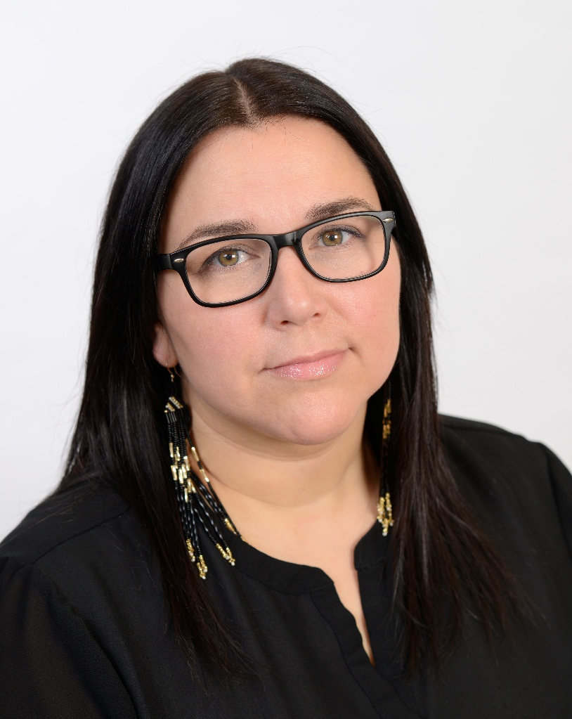
Nadine Vollant
Innu community of Uashat mak Mani-Utenam
As a social worker, you can be an agent of change for our communities.
Working in youth protection lets me be a guardian to our First Nations children.

Slide 30
Did you know?
You, too, can be an agent of change in your community, without being a social worker!
As a human relations officer, you work to maintain good relations with the community. You also support offenders return to the community.

Slide 31
Julian Dumont, Human relations officer – Youth protection
Julian is from Kitigan Zibi First nations

Slide 32
Add up your points!
Notes:
NOTE TO EDUCATORS
Ask students to add up their points using the score sheet in the Student Guide.
Announce the winner.
You can award a prize to the winning team.

Slide 33
Online Career Fact Sheets
Learn more about the careers discussed in class.
Discover other careers
Notary
Probation officer
Bailiff
and more!
Visit Éducaloi at educaloi.qc.ca/careers
Notes:
INFORMATION FOR STUDENTS
Éducaloi’s website presents 18 downloadable career fact sheets:
correctional officer, police officer
band councillor or band chief, MNA/MP
probation officer, Indigenous offender support officer, courtworker, addictions worker, social worker
lawyer, notary, judge, paralegal
legal secretary, court clerk, bailiff, court usher, legal interpreter
Each fact sheet includes this information:
role, main duties, skills needed, work environment, training, salary, etc.

Slide 34
The End
To learn more, visit Éducaloi’s website at
www.educaloi.qc.ca/en/youth

Slide 35
Copyright Notice
 | This Guide is intended for educators in Quebec.
 | None of the information in the Guide should be taken as legal advice.
 | It may not be used or reproduced for commercial purposes. It is the property of Éducaloi.
 | To ensure the reliability of the information provided, educators must use this Guide in its original form, without modification.
 | The information was updated on June 15, 2017.
© Éducaloi, 2017
Notes:
NOTE TO EDUCATORS
This slide is intended for educators.
To receive updates and new pedagogical tools, contact us at education@educaloi.qc.ca.
To sign up for our school newsletter, go to educaloi.qc.ca under Resources for Educators (approximately four emails per year).
35

