Slide 1
Let’s Learn About Careers in Law!

Slide 2
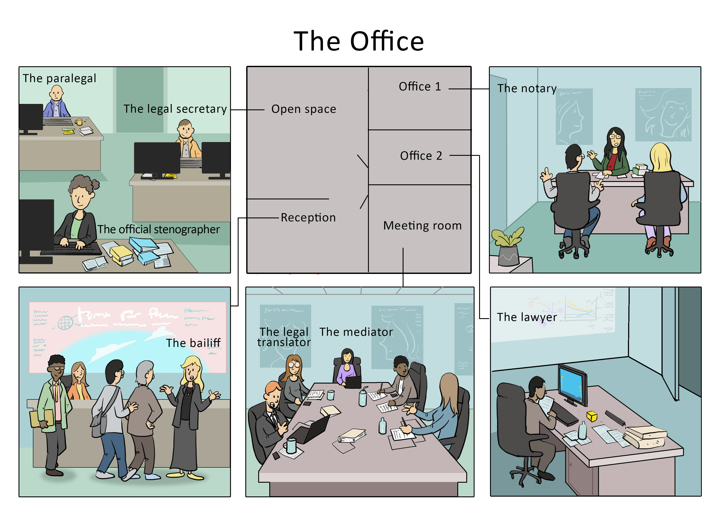
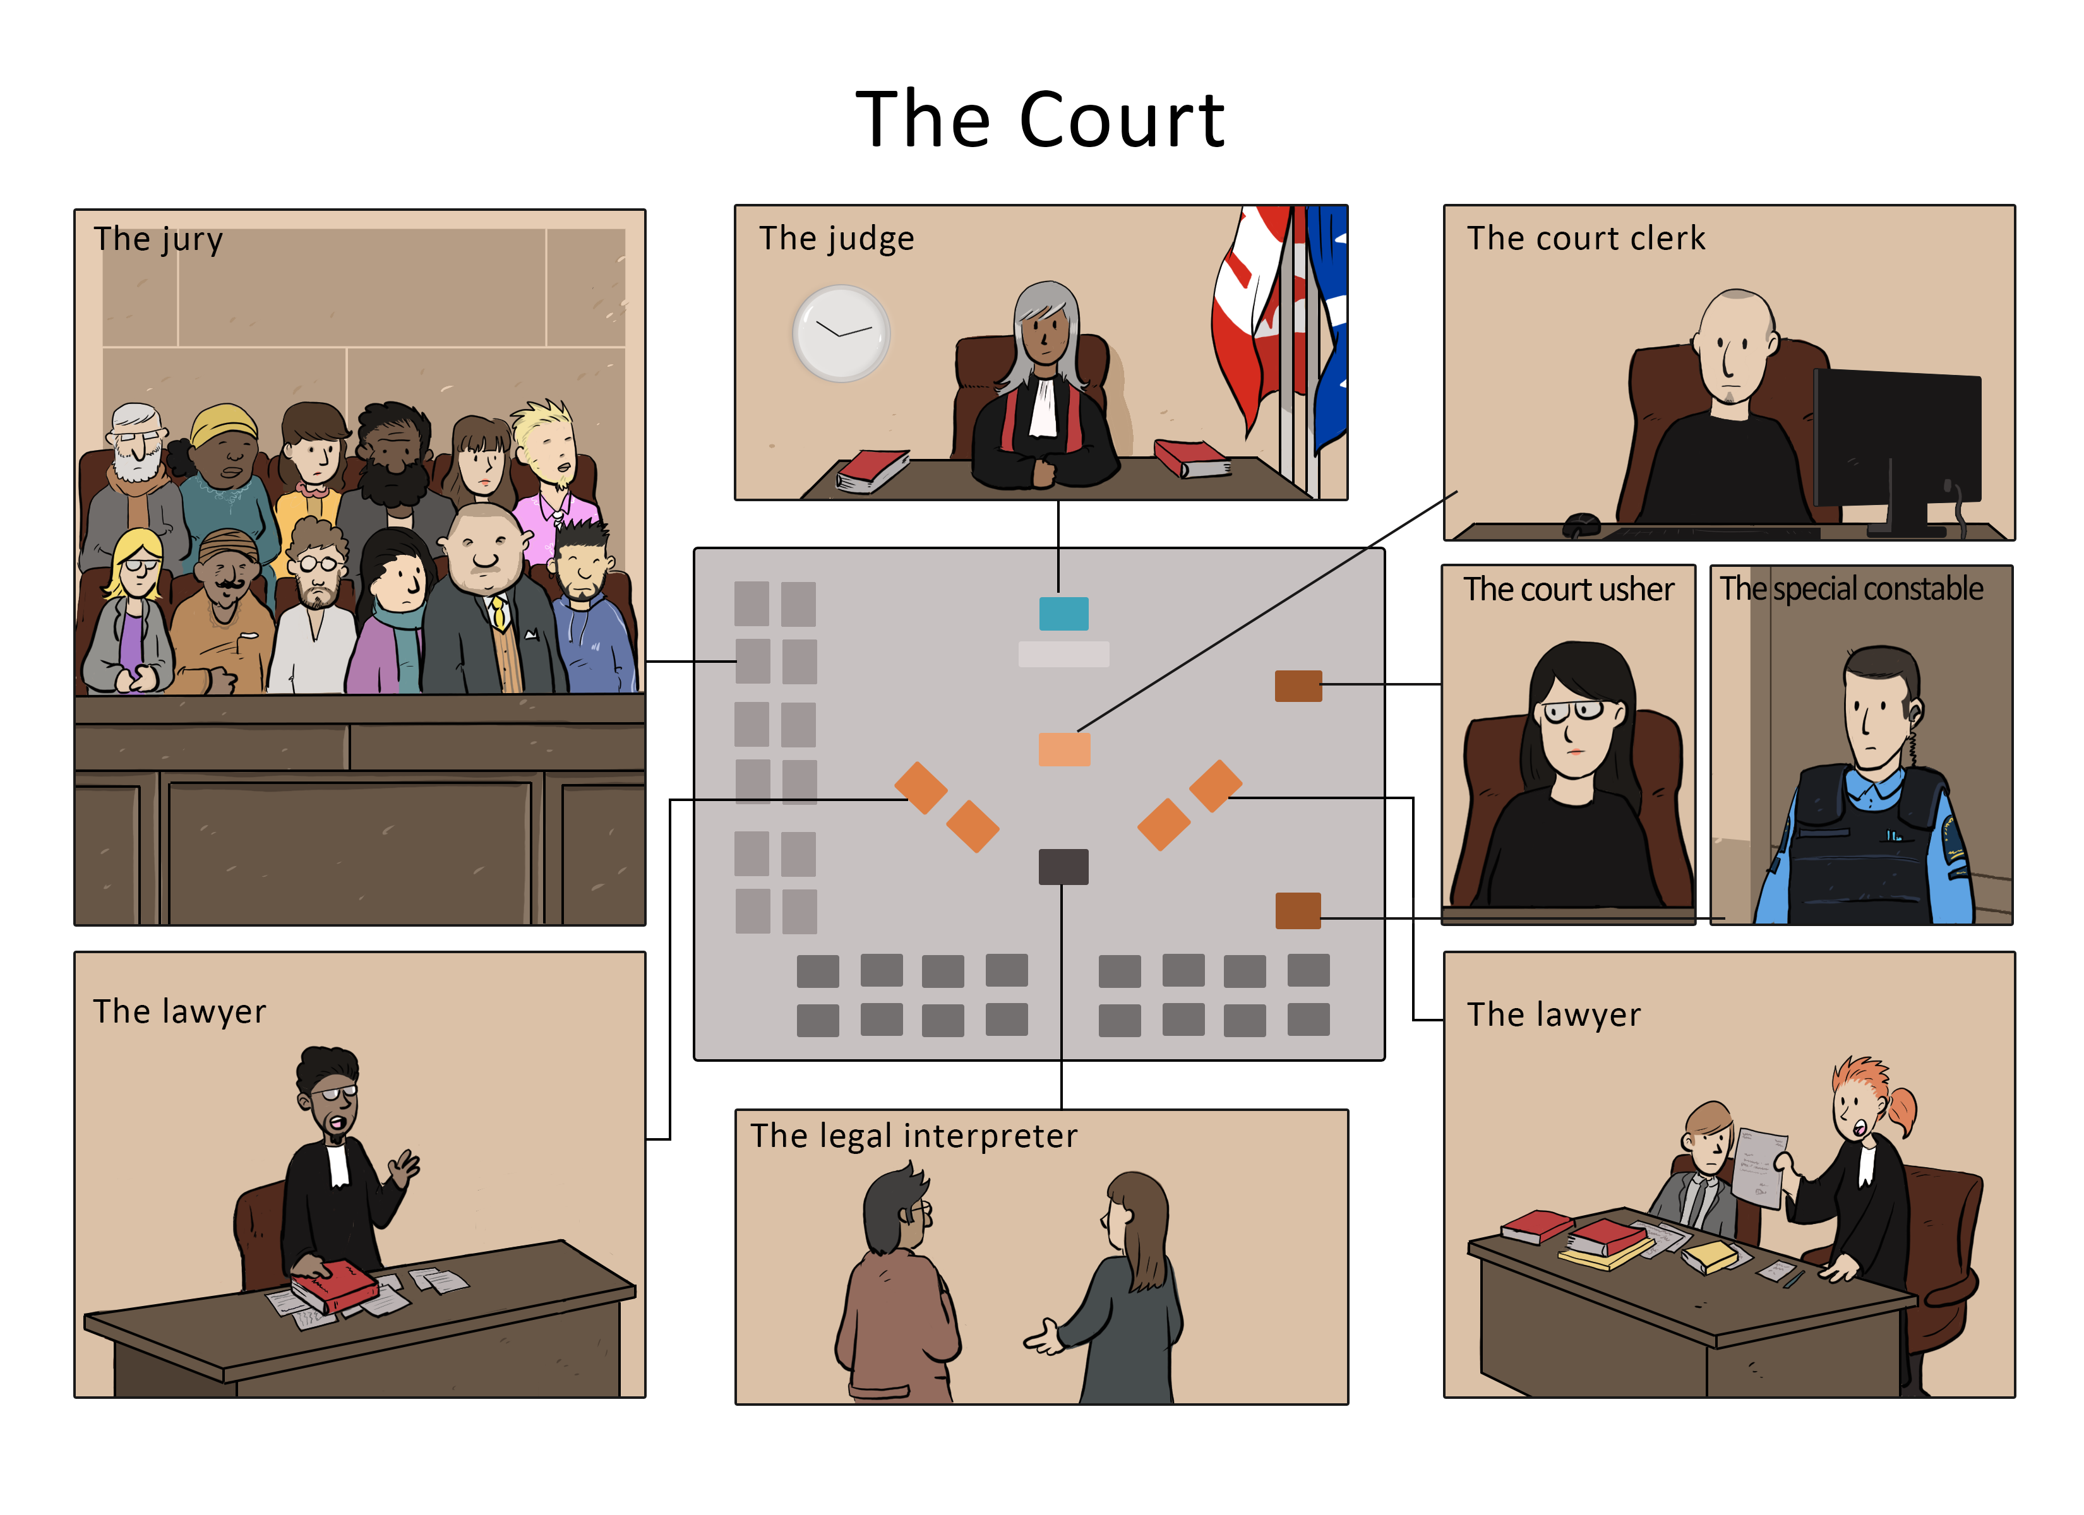
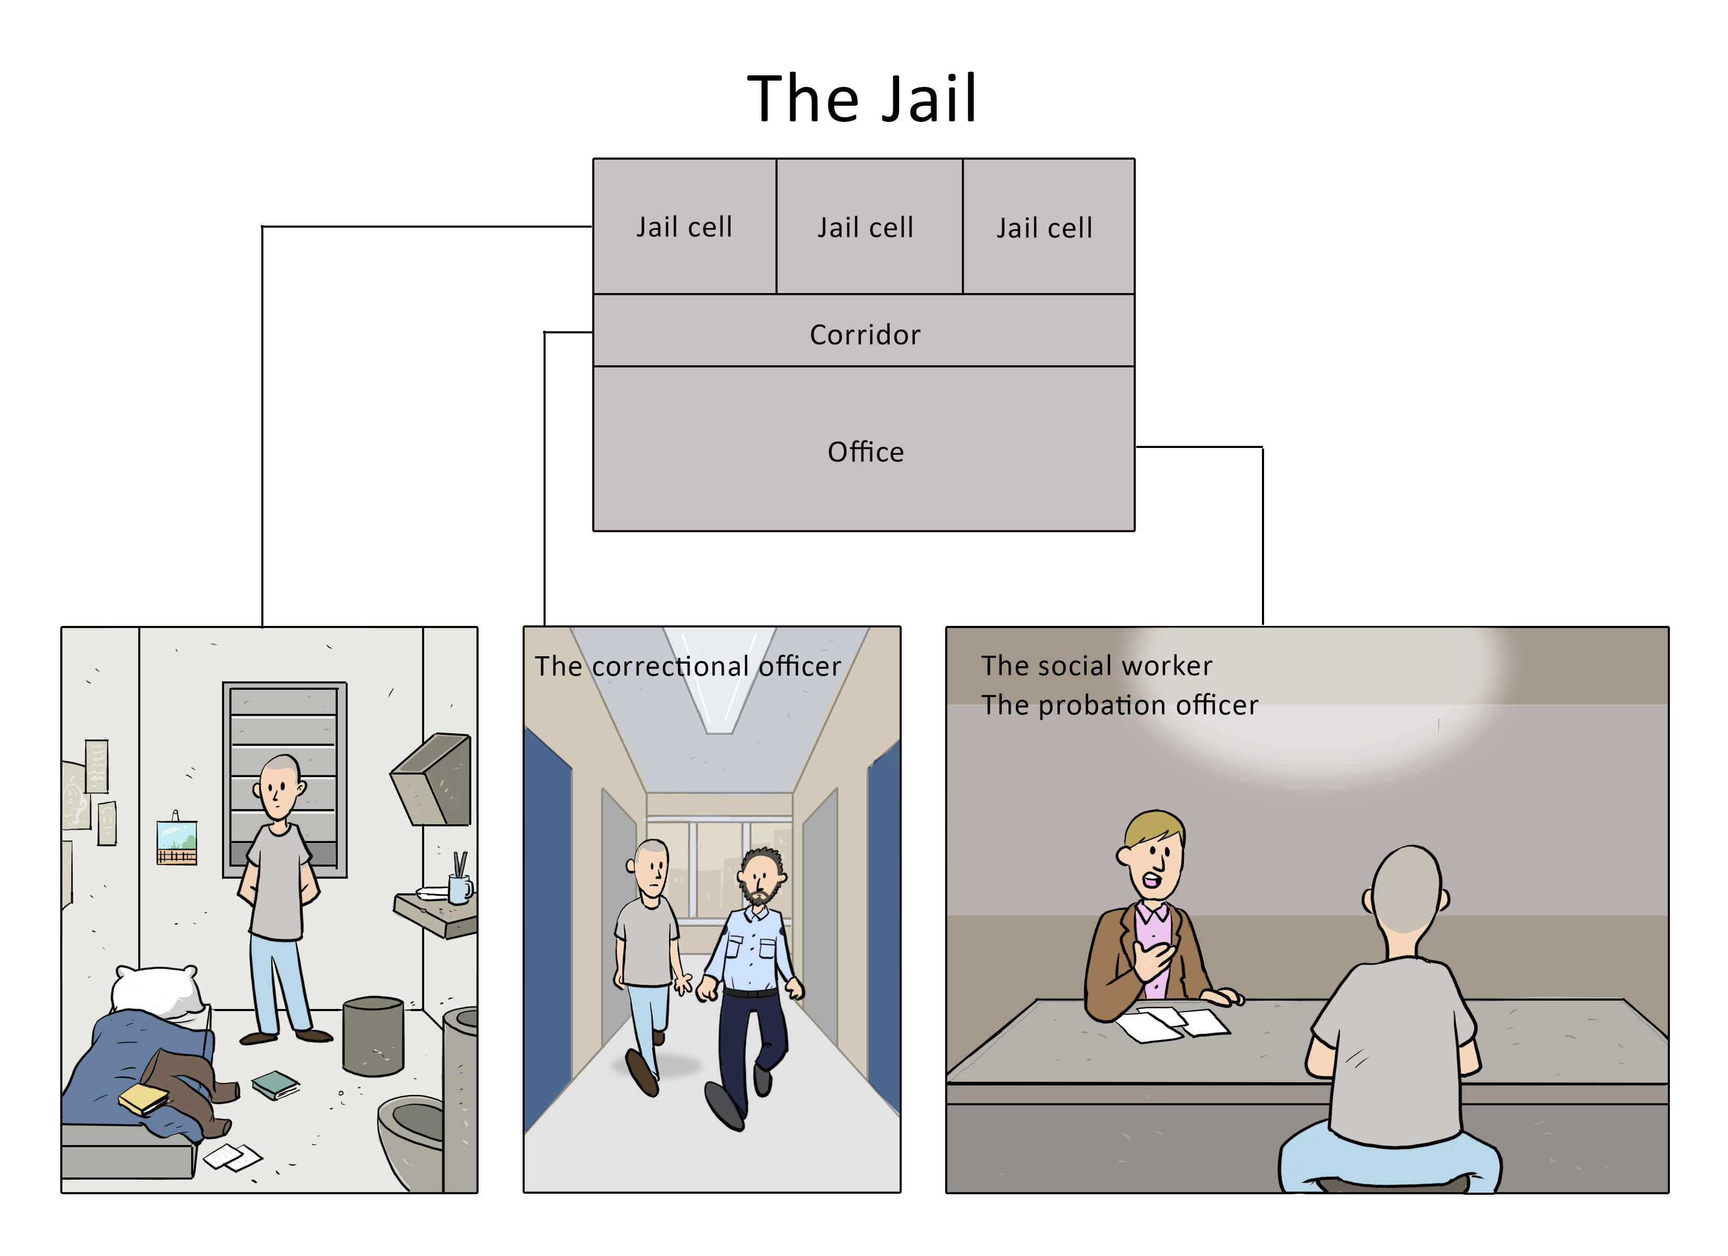
What do we mean by careers “in law”?
The law is all around us. Even though we may not always realize it, the law affects many of our everyday situations.
For example:
Notes:
TEACHER’S NOTES
This presentation was updated in September 2021. The Notes section of each slide contains a lot of additional information.
The images on this slide reflect several areas:
- Criminal law
- Contracts, notaries, divorce, etc.
- Court
- The Highway Safety Code
- Consumer goods and services.
This activity will allow students to learn about a wide variety of legal professions. We have separated these professions into three categories, depending on the setting where they are practised:
Court
Prison
Office

Slide 3
The Law
Who makes the law? | Who enforces the law?
Member of Parliament
/
Member of the National Assembly
Police Officer
Next
Notes:
TEACHER’S NOTES
When a student provides the correct answer, click the slide to make the right word appear in the box.
Answer: MPs and MNAs create laws and police officers enforce them.
These two professions are explained in more detail on the next two slides.

Slide 4
I create laws.
Member of Parliament (MP)
and
Member of the National Assembly (MNA)
MPs and MNAs are elected to represent the people who live in their riding (electoral division). They have a lot of duties, including:
voting for or against bills (proposed laws) to determine whether they will become law
doing work in their riding offices (when they are not at the Quebec National Assembly or the Canadian Parliament)
meeting with groups and individuals to discuss their requests
making sure that their community has what it needs, like jobs, education, government programs, etc.
Back
Notes:
TEACHER’S NOTES
Training
In Quebec, anyone who meets the following requirements can run for election as an MP or an MNA:
they must be a Canadian citizen
they must be allowed to vote
they must be at least 18 years old (on election day)
MNAs must have had their main residence in Quebec for at least six months
they must not be under curatorship
Students will probably have questions about curatorship.

Slide 5
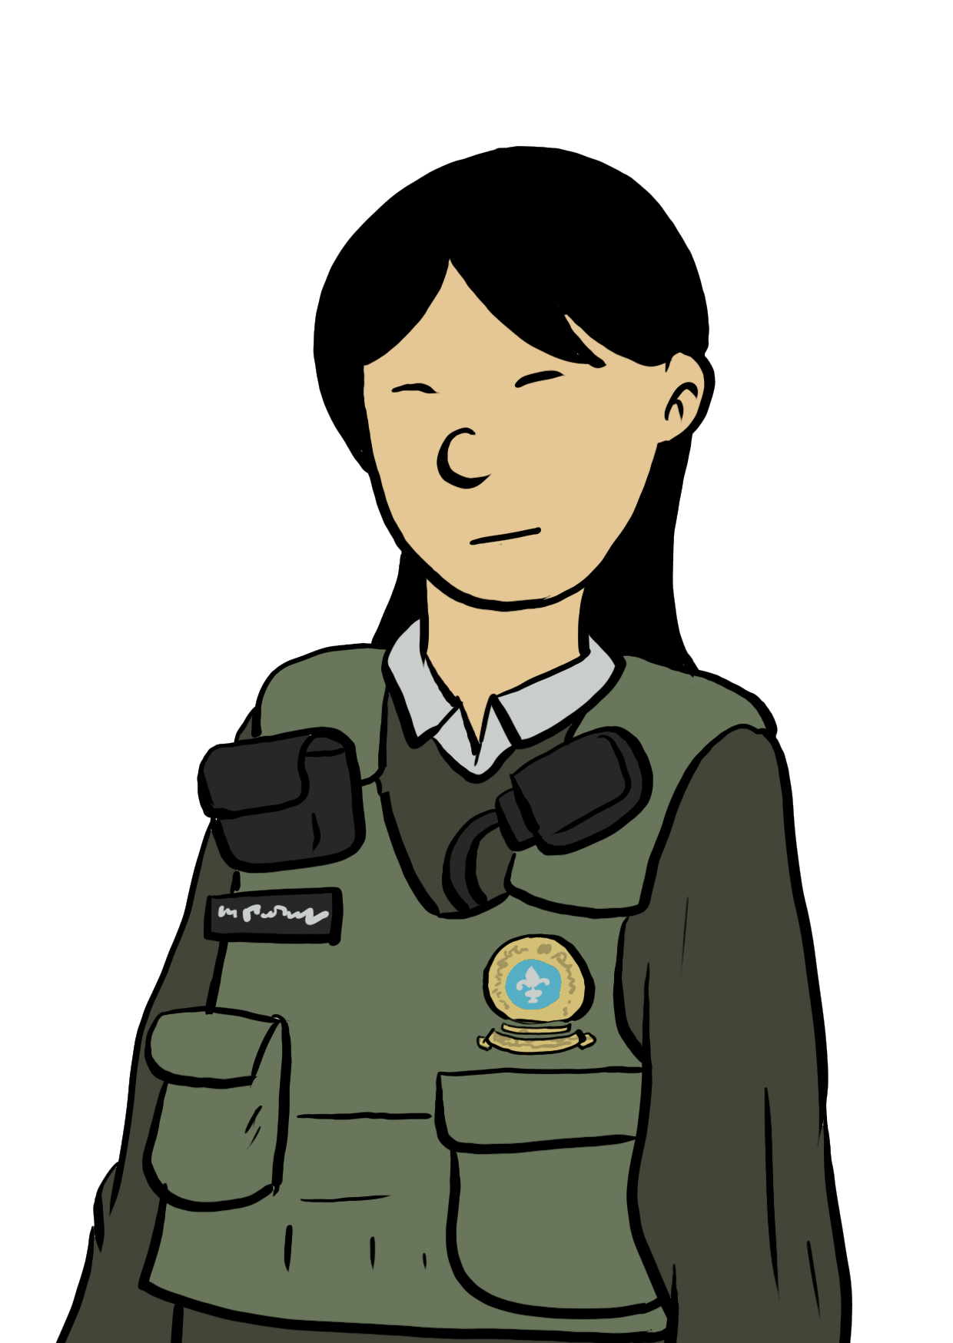
I enforce laws.
Police Officer
Police officers play an important role in society. They are responsible for:
protecting the public and preventing crimes
arresting people who commit crimes
gathering evidence to use in court against people accused of crimes
Police officers must respect people’s rights, especially the rights of people they arrest!
Back
Notes:
TEACHER’S NOTES
Training
To become a police officer in Quebec, you usually need a CEGEP diploma in police technology and training at the École nationale de police (Quebec police academy).
You can also become a police officer with a university degree or a vocational CEGEP diploma in another field, such as criminology or computer science. If you haven’t studied police technology, you must receive a job offer from a police department and then complete an Attestation of College Studies (ACS) in police technology and training at the École nationale de police.
To work for the Royal Canadian Mounted Police (RCMP), you need a high school diploma and six months of training at the RCMP Academy in Regina, Saskatchewan. Graduates of this program must be willing to work anywhere in Canada.
Main Duties
There are many different jobs in a police department, including patrol officers, community officers, firearms instructors, dog handlers, police trainers, desk officers, and investigators.
Most police officers start as patrol officers. They:
respond to emergencies
write tickets and arrest suspects
write reports after giving someone a ticket or arresting a suspect. Police officers must be able to justify their actions if anyone challenges them.
Investigators gather the evidence needed to convict suspects of crimes. They:
question witnesses and suspects at the police station or elsewhere
examine the scene of a crime or accident
build a file that can be used in court

Slide 6
The courts: A key part of the administration of justice
1
4
2
5
3
6
Next
Notes:
TEACHER’S NOTES
Click on a number to go directly to the slide for that profession. When you have looked at the slides for each profession, click “Next” to continue the presentation.

Slide 7
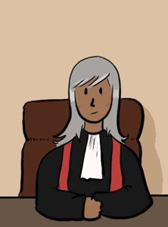
Judge
Judges conduct civil and criminal court cases. They decide who “wins” the case. Judges have many duties, including:
managing cases from beginning to end
directing court hearings to make sure everyone follows the rules
listening to what is said in court by lawyers, experts and other witnesses
analyzing evidence (the proof presented during the court case)
making a decision and explaining how it was made
Back
Notes:
TEACHER’S NOTES
Judges conduct civil and criminal court cases.
During the trial, they make sure everyone follows the rules of procedure.
After the trial, they have the difficult task of making a fair decision based on the law. They must do this by applying the law to the facts of the case.
This often means spending long hours in an office, reading and writing. Judges work both in their offices and in court.
Training
There is no “judge school” in Canada, but most judges are former lawyers.
Depending on the court, judges are selected by the federal or provincial government.
Judges are either former lawyers or former notaries. They must have practiced as lawyers or notaries for at least 10 years to be selected. Some judge positions are only open to lawyers, while others are also open to notaries.
Lawyers who become judges usually spent their careers representing people in court, but this isn’t a requirement.
Potential judges are chosen very carefully. They need to know the law inside out and have spotless professional and personal reputations.
Salary
Judges’ salary is set by the law and is made public. They receive a fixed yearly salary no matter how many hours they work.
Their salary depends on which court they work at. For example, municipal court judges don’t make as much as Supreme Court judges. But most judges earn more than $200,000 a year.

Slide 8
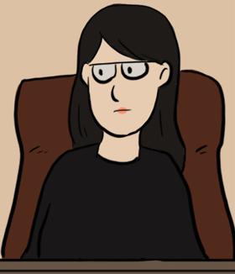
Court Usher
Court ushers make sure court hearings run smoothly.
They:
make sure everything is in order for the hearing
accompany judges between their offices and the courtroom
make sure everyone in the courtroom behaves properly
show witnesses where to stand and do jobs for judges, such as making photocopies
Back
Notes:
TEACHER’S NOTES
Court ushers play a discreet but essential role in the courtroom.
They:
prepare and then open the courtroom
help judges and accompany them between their offices and the courtroom
greet witnesses and show them where to stand during the hearing
make sure the people in the courtroom behave properly
help judges during the hearing, for example, by making photocopies
Training
There is no specific training program for court ushers.
Justice Quebec requires three years of secondary school, that is, Secondary Three or Grade 9. People who have less than three years of secondary school can still qualify if they have two years of work experience for each year of schooling they don’t have.
The department hires court ushers from its bank of job applicants.
Work Environment and Conditions of Employment
Court ushers work part-time and must be on call. Their work schedule might change from week to week depending on how busy the court is.

Slide 9
Court Clerk
Court clerks manage the administrative part of the court hearing.
They:
prepare and organize the court record
write the minutes, which is a document detailing everything that happens during a hearing
swear in witnesses, which means asking them to promise to tell the truth
make sure lawyers and witnesses are in the courtroom at the beginning of the hearing
schedule hearing dates according to when the lawyers are available
Back
Notes:
TEACHER’S NOTES
Court clerks work at the heart of the action. They must pay close attention to what goes on around them. They need excellent communication skills because they do a lot of writing. They have to be detail-oriented and very organized.
Court clerks work on call, which means they work only when the court needs them. Their work schedule changes from week to week.
Training
There is no specific training for court clerks.
However, employers often require them to have a Diploma of College Studies (DEC) in Paralegal Technology or three years of experience as a legal secretary.
Court clerks who work in the judicial district of Montreal should be bilingual, because hearings can take place in either French or English.

Slide 10
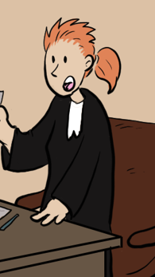
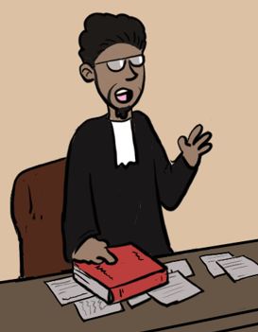
Lawyer
Lawyers can specialize in different areas of law (for example, criminal law, intellectual property, labour law, etc.). But no matter what type of law they practise, they all do similar things.
They:
listen to their clients and give them advice about their legal problems and the law
negotiate to settle disagreements
analyze documents and laws so they can answer their clients’ questions
represent their clients in court
write many legal documents to present in court or give to their clients
Back
Notes:
TEACHER’S NOTES
Lawyers do many things, depending on where they work (private, public or semi-public practice/in-house for a company or a non-profit) and what areas of law they work in (criminal law, intellectual property, labour law, commercial law, etc.).
Many lawyers represent clients, provide legal advice, and help settle disagreements.
Lawyers are officers of the court. This means they must have respect for the law and act with honour, dignity and integrity.
Training
To become a lawyer in Quebec you must have a bachelor’s degree from a law school.
You then have to pass the exams given by the École du Barreau (Quebec bar school). The purpose of these bar exams is to ensure you have the skills and knowledge to practise law in Quebec.
Finally, you have to do six months of practical training (“articling”) before you can officially become a lawyer. Then you are allowed to practise law by representing clients and giving legal advice.
Lawyers must keep their knowledge up to date throughout their career by attending 30 hours of continuing education classes every two years.
Work Environment and Conditions of Employment
“The law puts us into everything. It's the ultimate backstage pass.” Lawyers can work almost anywhere: in corporations, for the government, in small firms, in large international firms, and in non-profits. Some of them work on their own.
Lawyers’ income varies a lot. Almost 80% of lawyers earn between $30,000 and $200,000 a year, depending on their experience, the type of practice and clients they have, and how many hours they work.

Slide 11
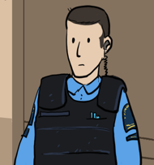
Special Constable
Special constables work in courthouses and other government buildings, where they maintain peace, order and security.
They:
participate in prevention, inspection, surveillance, escorting, custody, and investigations
arrest people, remove people from the premises, confiscate dangerous items
keep offenders in custody until social services or correctional services can take over
provide assistance and first aid in emergencies
Back
Notes:
TEACHER’S NOTES
Special Constables’ job is to maintain peace, order and security in courthouses and other government buildings.
This can mean that they:
confiscate dangerous items
arrest people or remove them from the premises
participate in prevention, surveillance, custody and investigations
Training
To become a special constable, you need a Diploma of College Studies (DEC) in police technology.
You must then take a twelve-week training program at the École nationale de police (Quebec police academy).
Salary
Special constables earn about $43,000 to $60,000 a year.

Slide 12
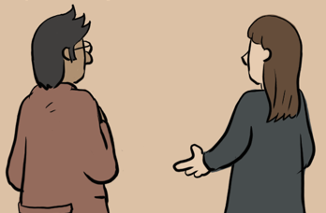
Legal Interpreter
Legal interpreters play an important role in our legal system. They help people exercise their rights in court, no matter what language they speak.
They:
prepare well before going to court by learning vocabulary that might be used during the trial
listen very carefully to what the witness, expert, lawyer or judge says
state in another language exactly what was said
translate written documents out loud if a judge or lawyer asks them to
Back
Notes:
TEACHER’S NOTES
Legal interpreters work mostly in court. They might also accompany legal professionals like lawyers and notaries to meetings or negotiations.
Interpreters have to concentrate at all times. Sometimes they must translate very technical or complicated terms and ideas.
Legal interpreters listen to what is being said and then translate it out loud. They must remain completely neutral and not take sides.
The words an interpreter chooses are important. Good interpreters pay close attention to what a person says and translate it as accurately as possible. They must concentrate for hours at a time, and they must be good communicators.
Training
There is no specific training for legal interpreters, but most have studied translation or languages. Legal training is not necessary but can be very useful.
Several Quebec universities offer a bachelor’s program in translation.
To be a certified legal interpreter, you must become a member of the Ordre des traducteurs, terminologues et interprètes agréés du Québec (association of certified translators, terminologists and interpreters). But you can work as a legal interpreter without being certified by the OTTIAQ.
It’s a good idea for legal interpreters to register with the legal interpretation and translation department of their local courthouse. They must pass an exam to have their names included on the list of interpreters at the courthouse.

Slide 13
If the accused person is convicted of a serious crime, they go to: prison.
1
2
3
Next
Notes:
TEACHER’S NOTES
Click on a number to go directly to the slide for that profession. When you have looked at the slides for each profession, click “Next” to continue the presentation.
An accused person who is convicted of a serious crime will go to a detention center, which means either a penitentiary or a prison.
Penitentiaries are run by the federal government. They are for people with sentences (punishments) of two years or more.
Prisons are run by the provincial government. They are for people with sentences of less than two years, or who are awaiting trial.

Slide 14
Correctional Officer
Correctional officers supervise prisoners and maintain order in places where prisoners are kept, but their role does not end there.
They:
make sure rules are followed and use physical or verbal force when necessary
accompany prisoners to the hospital or to court
evaluate prisoners’ records and help them return to the community
Back
Notes:
TEACHER’S NOTES
Note: The name of this profession depends on whether the prison where the person works is provincial or federal: federal = “correctional officers” and provincial = “correctional service officers”.
Prison is a tough environment. Correctional officers have to adapt well to changing conditions.
They deal with tense and difficult situations, much like psychologists, paramedics and fire fighters.
Correctional officers patrol areas where prisoners are kept. They conduct searches. At times they have to use physical force and arrest people. Communication is their most important tool.
Training
To be a correctional officer, you need:
a high school diploma
a certificate in standard first aid and CPR
a class 4A driver’s licence (emergency vehicles)
You must pass written tests, go for an interview and have your fingerprints taken. You must also complete a medical questionnaire and give the government your written consent to do a background check.
Work Environment and Conditions of Employment
Correctional officers work for the federal and provincial governments. They usually work in penitentiaries and prisons.
Sometimes, correctional officers work outside the prison or penitentiary, for example, when accompanying prisoners to court or to the hospital.

Slide 15
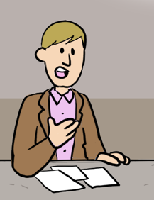
Social Worker
Social workers help people understand and solve their problems.
They:
meet with people, alone or in groups, to learn about their problems and to decide what services they need
give advice and help people learn skills to solve their problems
develop programs to help people
act as family mediators
Back
Notes:
TEACHER’S NOTES
In prison settings, the same person often works as a social worker and a probation officer, even though different training is required for these positions.
Training
Social workers need a bachelor’s or master’s degree in social work or social services. Several Quebec universities offer these programs.
“Social worker” is a title reserved only for members of the Ordre des travailleurs sociaux et des thérapeutes conjugaux et familiaux du Québec (OTSTCFQ), which is the professional association for social workers. Only members of this association are allowed to work as social workers.
Work Environment and Conditions of Employment
Social workers work in community centres, health centres, shelters, youth centres, prisons, schools, and even on the streets.
They often work with other specialists, including doctors, teachers, lawyers and psychologists.

Slide 16
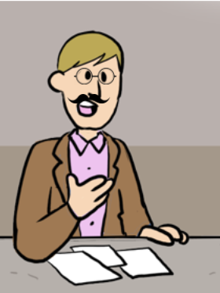
Probation Officer
Probation officers help offenders on parole and probation return to the community.
They:
prepare intervention plans to help offenders take responsibility for themselves
make sure that offenders meet the conditions of their probation or parole
write evaluation reports on offenders’ behaviour
Back
Notes:
TEACHER’S NOTES
Probation officers help offenders on parole and probation return to the community. Note that at the federal level, this profession is called “parole officer”.
Probation officers and parole officers talk with offenders to understand and evaluate their situation and needs, and to give them advice. They help offenders take responsibility for themselves: finding a job and a place to live, recovering from addiction, etc.
They also keep track of offenders who have been released. They meet with them on a regular basis and make sure they follow their probation or parole conditions. For example, they check whether offenders are home by a specific hour and attend their therapy appointments.
Training
To become a probation officer, you must have a bachelor’s degree in one of the following fields: criminology, psychology, psychoeducation, law, social work, social services, guidance, school and vocational counselling, sexuality, or another related field.
When you apply for a job as a probation officer, you must go through a selection process. If you get the job, you must follow a training program given by Quebec’s correctional services department.
Work Environment and Conditions of Employment
Probation officers work for the provincial government. Parole officers work for the federal government.
Probation and parole officers work in prisons or courthouses. They work closely with correctional officers, social workers and other professionals.

Slide 17
Not all probation and parole officers work in courthouses:
some work in offices.
1
2
7
4
3
5
6
Next
Notes:
TEACHER’S NOTES
Click on a number to go directly to the slide for that profession. When you have looked at the slides for each profession, click “Next” to continue the presentation.

Slide 18
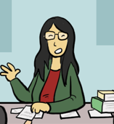
Notary
Notaries give advice to clients at important times in their lives, like when they buy property, get married, make a will, or start a business.
They:
give legal advice to prevent or solve problems
write documents that follow special legal rules
make sure their clients are protected legally and financially
represent clients in court in cases where people are not opposing one another
Back
Notes:
TEACHER’S NOTES
“Prevention is better than a cure” could be the motto for notaries. This is because notaries often act in advance to prevent a dispute or legal problem from arising later.
They must foresee all the possible scenarios in situations like:
marriage contracts
cohabitation agreements
wills
Main Duties
Notaries give legal advice to clients in order to prevent or solve problems. Notaries sometimes act as mediators in a dispute.
For example, a marriage contract can lay out what will happen if the marriage ends.
Notaries write documents that follow special legal rules, after doing research and checking necessary information. Notarial documents are “authentic.” This means the documents have special legal status and are hard to challenge.
For example, if a notary writes a will, it will be very difficult in the future to claim that those instructions are not what the deceased person wanted.
Notaries make sure their clients are protected legally and financially, for example, when selling a house or a business, or when paying off a mortgage.
When you buy a house, for example, the notary makes sure that the house really belongs to the seller and does not already have a mortgage on it.
Sometimes notaries represent clients in court.
For example, a notary can ask a judge for emergency measures to protect a vulnerable person.

Slide 19
Paralegal
What paralegals do depends on where they work.
They:
write drafts of legal documents that a lawyer will finalize
research laws, judges’ decisions, legal textbooks and other sources (for example, to find arguments that will convince a judge)
do some work that legal secretaries do, especially if they work in a small firm
Back
Notes:
TEACHER’S NOTES
Training
To become a paralegal, you usually need a Diploma of College Studies (DEC) in paralegal technology.
Some employers don’t require this DEC and prefer to train their paralegals themselves.
Main Duties
What paralegals do depends on where they work. Their main role is to help lawyers do their job.
This could involve writing legal documents and researching laws, judge’s decisions, and other sources. They may also do some work that legal secretaries do (answering the phone, managing the calendar, etc.), especially if they work in a small firm.
Work Environment and Conditions of Employment
Paralegals work in a wide variety of locations. They can work in law firms, notarial firms, legal departments of companies, for courts or the government, and other places.

Slide 20
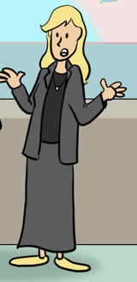
Bailiff
Bailiffs sometimes have to do tough jobs, like evicting tenants who haven’t paid their rent. But this is not all they do.
They:
deliver legal documents directly to people
carry out court orders
prepare official reports on situations, such as an apartment in bad shape
collect money that people owe or get them to voluntarily hand over property
Back
Notes:
TEACHER’S NOTES
Bailiffs often have a bad reputation.
This is because they have to work in difficult situations and carry out unpleasant tasks, like seizing property, evicting tenants, or telling someone that they are being sued.
But this shouldn’t keep us from seeing that bailiffs are also go-betweens and negotiators. They spend part of their time finding solutions to some difficult situations, such as bankruptcy, divorce and unemployment.
Training
To become a bailiff you need a Diploma of College Studies (DEC) in Paralegal Technology or a bachelor’s degree from a law faculty. You also need a permit from the Chambre des huissiers de justice du Québec, which is Quebec’s professional association of bailiffs. To get a bailiff’s permit you must meet these requirements:
complete a five-week training program
complete a six-month supervised internship
pass the exam set by Quebec’s professional association of bailiffs
Bailiffs also have to take 12 hours of continuing education courses every two years. These courses cover new developments in the profession and help bailiffs brush up on their skills and learn new ones.
Work Environment and Conditions of Employment
Bailiffs work in an office, either alone or as part of a team. They also travel a lot by car. They might have to work early in the morning, late at night or on weekends.

Slide 21
Official Stenographer
When people are questioned out of court, official stenographers record what was said and done. Judges rely on these notes (called transcripts) when making their decisions after a trial.
Stenographers may also be asked to write out (transcribe) what was said in the courtroom during a court case.
Most of the time they aren’t present in the courtroom during a hearing. Rather, they prepare the transcript afterwards, using a sound recording.
Back
Notes:
TEACHER’S NOTES
Official stenographers play an important role in our legal system.
Transcripts are very important when a decision is appealed because judges rely on them when making their decisions.
Official stenographers record either by: typing very fast on a strange-looking keyboard that uses phonetic symbols (“stenotype”), or by repeating everything they hear into a recording mask (“stenomask”).
Training
To become an official stenographer in Quebec, you must:
have an Attestation of College Studies (AEC) in legal stenography. This two-year program is offered in French by the École de sténographie judiciaire du Québec. Students learn shorthand, stenography techniques and legal vocabulary.
pass the exam of the Comité sur la sténographie of the Barreau du Québec (stenography committee of Quebec’s professional association of lawyers). The exam is difficult. To pass, you need 90% for the spelling and grammar part and 80% for stenography techniques.
Work Environment and Conditions of Employment
Official stenographers are not employed by the court. They are self-employed and sometimes work in a stenographers’ office. They spend a lot of time listening to sound recordings of what people said in the courtroom or when being questioned, but they work mostly at home or at the office.
The government decides how much a stenographer can charge in fees:
$85 an hour to record what is said by a witness
from $4 to $11 per page, depending on the type of witness and how much time they are given to prepare it
Stenographers can also make payment arrangements with their clients for specific cases.

Slide 22
Legal Translator
Legal translators are true communication experts. They translate legal documents, making sure the legal meaning stays the same.
They:
analyze documents to understand exactly what they mean
do a lot of research
accurately translate legal documents from one language to another while making sure their legal meaning stays the same
revise translations done by other translators
correct texts to make sure they are well written
Back
Notes:
TEACHER’S NOTES
Legal translators play an important role, especially in a country where two official languages live side by side!
Legal translators translate legal documents, such as contracts, laws and court decisions, from one language to another. With their language skills, they can also write, revise and correct documents.
Training
There are different ways to become a legal translator. These are the two most common:
some begin by studying translation or languages, usually in university, and then specialize in law
others begin by studying law and then study translation later.
sometimes lawyers develop translation skills on the job and later specialize in legal translation.
Several Quebec universities offer a bachelor’s degree or certificate programs in translation and a bachelor’s degree in law.
Work Environment and Conditions of Employment
Legal translators work in a variety of environments. They can work for the government or in companies, law firms and translation agencies. Many are self-employed.

Slide 23
Mediator
When two parties want to settle a disagreement without going to court, they can choose a mediator to help them find a solution.
Mediators:
remain neutral and do not take sides
listen carefully to both parties
propose solutions without imposing them
Back
Notes:
TEACHER’S NOTES
Mediators are increasingly important in our justice system. Mediation is an important part of alternative dispute resolution and the participatory justice approach. Participatory justice is a new approach to justice that is different from the conventional approach in the following ways:
it involves direct participation in the decision-making process by the people who are most affected by it
it takes more than just the law into account by also focussing on the human, economic and social aspects of the disagreement
it promotes a sense of justice and fairness
Mediators must be impartial, which means that they cannot take sides.​
Training
A mediator can be anyone the parties choose.​ With some exceptions, anyone whom the parties trust can be their mediator.​
They must also be neutral, which means that their personal beliefs must not influence their work.​
​​
​

Slide 24
Legal Secretary
Legal secretaries work as assistants to lawyers, notaries and judges. They work on many files at the same time and keep a close eye on deadlines.
They:
perform secretarial tasks
prepare and format legal documents
manage files and make sure deadlines are met
collect amounts billed to clients
Back
Notes:
TEACHER’S NOTES
Training
To become a legal secretary, you usually need an Attestation of Vocational Specialization (AVS) for legal secretarial work. This is a 450-hour program that is offered in English and in French.
To apply to the program, you need a Diploma of Vocational Studies (DVS) for secretarial work or relevant work experience.
Work Environment and Conditions of Employment
Legal secretaries usually work in these places:
law firms, notarial firms and judges’ offices
federal, provincial and municipal governments
companies
Wages for legal secretaries vary greatly. Experienced legal secretaries who work for the government earn about $45,000. In big law firms, experienced legal secretaries can earn more than $60,000 a year.

Slide 25
Quiz
Who am I?
SCORE
If the team gets the answer using... | They get...
1 clue | 4 points
2 clues | 3 points
3 clues | 2 points
4 clues | 1 point
Notes:
TEACHER’S NOTES
Divide students into two to four teams. The scoresheet attached to the Teacher’s Guide has room to keep score for up to ten teams. Students may enjoy choosing a team name related to the law.
Explain to students that you will give them clues and they must guess which legal profession you are describing.
Tell them how to make their guesses (e.g., the first team to raise their hand, taking turns, etc.) and how the scoring works.
Give students a clue and ask them to guess the profession. If they can’t, give them another clue.
The first clue is the hardest and they get easier as you go. The fewer clues a team needs to guess the right answer, the more points they will score!
Score
The team gets 4 points if they only need 1 clue.
The team gets 3 points if they need 2 clues.
The team gets 2 points if they need 3 clues.
The team gets 1 point if they need all 4 clues.

Slide 26
Who am I?
To do my job, I need a bachelor’s degree in law and a master’s degree, and I must also be a member of the professional association.
I give advice to clients at important times in their lives, like when they get married, buy a home, or when a loved one dies.
I can officiate weddings, and I am often asked to prepare authentic documents, like deeds and wills.
I am a... R - O - T - A - N - Y
Notes:
TEACHER’S NOTES
Click the slide to bring up a the next clue.
Answer: Notary

Slide 27
Who am I?
I work closely with lawyers, notaries and bailiffs.
My work is essential to the operation of a law firm or notarial office.
My tasks are varied: I answer the phone, prepare and format legal documents and manage files.
I am a... C - A - T - E - R - E - R - S - G - A - L - L - E - Y
Notes:
TEACHER’S NOTES
Click the slide to bring up a the next clue.
Answer: Legal Secretary

Slide 28
Who am I?
I work at the heart of the action during a court case.
I wear a black robe but I'm not necessarily a lawyer.
I spend most of my time in the courtroom, where I sit in front of the judge. I am the one who says, “Do you swear to tell the truth, the whole truth, and nothing but the truth?”
I am a... C - U - R - L - R - O - C - K - E - T
Notes:
TEACHER’S NOTES
Click the slide to bring up a the next clue.
Answer: Court Clerk

Slide 29
Who am I?
Most of my colleagues work in private practice, and some of us work in the public or parapublic sector, for private companies, or for community organizations.
I am a member of the Quebec bar.
I represent my clients in court and give them legal advice to help them understand their rights and obligations.
I am a... W - E - A - R - L - Y
Notes:
TEACHER’S NOTES
Click the slide to bring up a the next clue.
Answer: Lawyer

Slide 30
Who am I?
I help people solve disagreements through communication and cooperation.
I have to be impartial, and have excellent listening and communication skills.
To be certified, I need training recognized by the Department of Justice.
I am a... R - O - A - D - T - I - M - E
Notes:
TEACHER’S NOTES
Click the slide to bring up a the next clue.
Answer: Mediator

Slide 31
Who am I?
I work with people who have been convicted of crimes.
I help people return to the community after they have been in prison.
I make sure that people follow the rules for their release from prison.
I am a... B - O - N - F - I - R - E - O - F - A - P - R - I - C - O - T
Notes:
TEACHER’S NOTES
Click the slide to bring up a the next clue.
Answer: Probation Officer

Slide 32
Who am I?
I need good writing skills and must pay close attention to detail.
Lawyers rely on me the way doctors rely on nurses.
Lawyers rely on me the way doctors rely on nurses.
When I finish my legal research for a case, I can give my opinion to my boss, but not to clients.
When I finish my legal research for a case, I can give my opinion to my boss, but not to clients.
I am a... A - L - A - R - G - E - P - A - L
Notes:
TEACHER’S NOTES
Click the slide to bring up a the next clue.
Answer: Paralegal

Slide 33
Who am I?
I have to be at least 18 years old on election day.
I listen to the requests and needs of the people in my riding and represent them in Parliament or the National Assembly.
Lawyers rely on me the way doctors rely on nurses.
I have to be a good listener, thorough, and a good collaborator.
I am a... I - M - P - E - N - E - T - R - A - B - L - E - F - O - R - M - A - M
Notes:
TEACHER’S NOTES
Click the slide to bring up a the next clue.
Answer: Member of Parliament (or Member of the National Assembly)

Slide 34
Who am I?
I work with people directly. I have to listen carefully and communicate well so that I can understand their problems.
Quiz
I work together with other health, education and legal professionals to help the people I serve.
I help people find effective and lasting solutions to their problems and am often faced with difficult situations.
I am a... C - R - O - A - K - I - E - R - O - W - L - S
Notes:
TEACHER’S NOTES
Click the slide to bring up a the next clue.
Answer: Social Worker

Slide 35
Who am I?
I work in an office, either alone or as part of a team, and I often have to drive all over the city. I sometimes work early in the morning, late at night or on weekends.
I deliver legal documents to people.
I carry out court orders. This means making sure that the judge’s decision is followed and taking appropriate action if not.
I am a... A - L - I - B - I - F - F
Notes:
TEACHER’S NOTES
Click the slide to bring up a the next clue.
Answer: Bailiff

Slide 36
Who am I?
I work in courthouses and other government buildings.
I participate in prevention, inspection, surveillance, escorting, custody, and investigations.
I have to be observant, disciplined, and in good shape.
I am a... P - E - L - I - C - A - N - O - B - S - T - A - C - L - E - S
Notes:
TEACHER’S NOTES
Click the slide to bring up a the next clue.
Answer: Special Constable

Slide 37
And the winning team is...

Slide 38
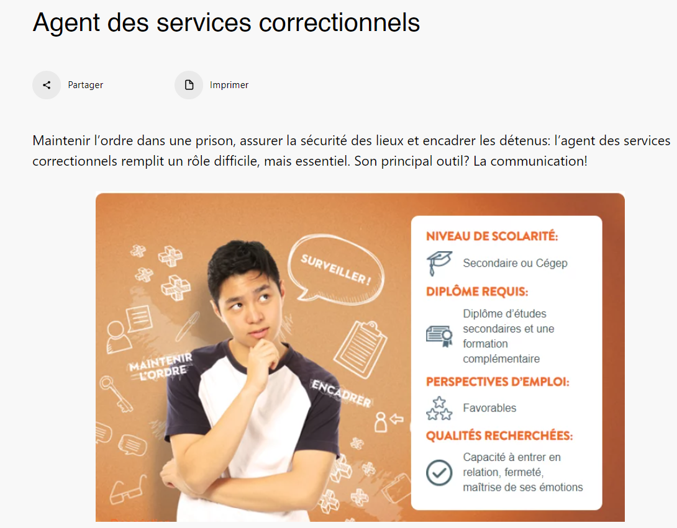
For more information...
https://educaloi.qc.ca/en/categories/legal-careers/
Notes:
TEACHER’S NOTES
Order a free copy of our Careers in Law pamphlet and we will ship it to your school free of charge.
Simply fill out the form at: https://educaloi.qc.ca/en/order-educalois-products/
(Click on “Promotional Pamphlets and Posters”, then select “Pamphlet about Careers in Law”).

Slide 39
Instagram/educaloi_en
YouTube/educaloi
Facebook/educaloi
educaloi.qc.ca/en

